Slide 1
Lecture #4: Data Collection with Surveys
[Course Instructor]
[Course Semester]
[Course Number]
Materials developed by C. Brakewood, K. Watkins, and J. LaMondia.

Slide 2
Outline: Surveys
Types of surveys.
Methods of sampling.
Survey content.
Survey instruments.
In-class exercise.
Data collection plan.
Example: Chicago Transit Authority Survey.

Slide 3
Types of Surveys

Slide 4
Types of Surveys
Longitudinal survey
Over time
Cross-sectional survey
Single point in time
Notes:
The lecture will focus on cross-sectional surveys, since they are most common in transit.
Cohort studies a focus on a particular population, sampled and studied more than once.
Panel studies allow the researcher to find out why changes in the population are occurring, since they use the same sample of people every time. That sample is called a panel.

Slide 5
Survey Methods
Goal: Transit rider survey
How: Intercept onboard vehicle or at stop/station
Methods:
Self-administered written questionnaire
Personal interview and written questionnaire
Personal interview and handheld tablets
Two-Step Methods
First: Recruit onboard or in-stations
Second: Online or Computer-Aided Telephone Interview (CATI)
Source: TCRP Synthesis 138; pages 10-11
Notes:
Method 1: Self-administered
What is it? paper surveys are distributed to passengers on transit routes or stop/stations by either a surveyor or the driver. Respondents return the completed form either as they disembark or by mail.
Method 2: Personal interview and written questionnaire
What is it? A surveyor fills out a written survey questionnaire while walking the respondent through each question, providing clarification and guidance as needed.
Method 3: Personal interview and handheld tablets
What is it? Surveyors engage in person interviews with individual transit riders and fill out electronic survey instruments on handheld devices (often iPads).
Method 4: Two step methods
What is it? Recruit riders onboard or in-stations; then give the information on how to take a longer, more detailed survey.

Slide 6
Method 1: Self-administered paper surveys
Strengths
Weaknesses
Source: TCRP Synthesis 138; page 13

Slide 7
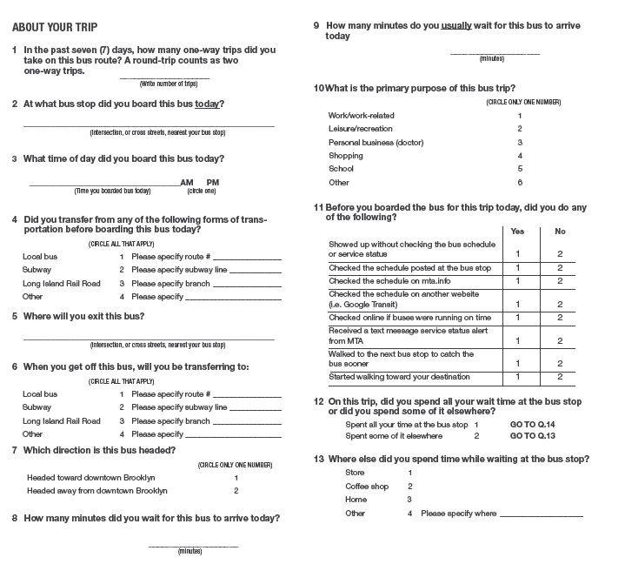
Example: Self-administered paper survey
Source: Candace Brakewood & MTA
Notes:
Cover page: has instructions and incentive.
Questionnaire: Short questions with as many multiple response questions as possible.
This survey was conducted on a single bus route to examine a pilot program.

Slide 8
Method 2: Interview-administered paper surveys
Strengths
Weaknesses
Can be conducted alongside self-administered surveys to accommodate persons with certain disabilities, limited English proficiency, or limited literacy
Does not benefit from the automation available in the tablet surveys
Source: TCRP Synthesis 138; page 13

Slide 9
Method 3: Interview-administered tablet surveys
Strengths
Weaknesses
Better data quality
Ability to incorporate auto validation and skip logic into survey instrument
Allows for tracking of responses in real time; can identify systematic biases or sampling issues more easily
Streamlined data entry and data cleaning
Interview approach can more flexibly accommodate users with low literacy or limited English-speaking ability
May result in high costs due to increase in staff house to administer survey
Some users may be uncomfortable sharing personal details in an interview setting
Challenging to conduct in a crowded setting or place where user has limited time to participate in an interview
Source: TCRP Synthesis 138; page 13

Slide 10
Method 4: Two-step Surveys
Strengths
Weaknesses
Source: TCRP Synthesis 138; page 13

Slide 11
Survey Approaches Used in Practice
Paper surveys are still the most common approach.
Source: TCRP Synthesis 138; page 28
Notes:
TCRP Synthesis 138 – conducted a survey of 67 transit agencies and Metropolitan Planning Organizations (MPOs).
Asked about the surveys that they completed recently and focused on Origin-Destination surveys
Respondents most often conducted surveys by paper (67%) or by tablet computer (53%).
A much smaller share of respondents conducted surveys online or with a two-step approach

Slide 12
Methods of Sampling
We can’t survey every single transit rider, so we select some to survey using

Slide 13
Methods of Sampling
Methods:
Simple Random Sampling
Systematic Sampling
every n^{th} unit selected
Stratified Sampling
divide the population into groups (strata); take a sample within each group
Others
Source: TCRP Synthesis 138; pages 18-19
Notes:
Target population: theoretical population. This could be transit riders if we want to study overall customer satisfaction; it could be transit trips if we want to study origin-destination travel patterns
In a simple random sample (SRS) of a given size, all such subsets of the frame are given an equal probability.
Systematic sampling relies on arranging the study population according to some ordering scheme and then selecting elements at regular intervals through that ordered list. Systematic sampling involves a random start and then proceeds with the selection of every k^{th} element from then onwards. A simple example would be to select every 10th name from the telephone directory.
In stratified sampling, the population is divided into strata according to some variables that are thought to be related to the variables that we are interested in. Then a sample is taken from every stratum. Common example: by mode (bus or train).
There are others, like cluster sampling, etc.

Slide 14
Sample Size Determination
Depends on the population size (e.g., number of riders) and the level of precision desired
Increase sample size → increase costs
Example for Simple Random Sampling
Source: TCRP Synthesis 63; page 16
Notes:
Table from TCRP Synthesis 63 (2005)
Rule of thumb: ~400 responses

Slide 15
Survey Content
What is commonly included in transit surveys?

Slide 16
Research Goals & Content
Origin & Destination Surveys
“This trip”: Origin, destination, purpose, access mode, egress mode, etc.
General Travel Behavior
Frequency of travel, how long using transit, alternative modes
Demographics
Gender, age, race, driver’s license, HH income, HH size, employment status
Satisfaction
Attributes of service: timely service, speed of service, cleanliness, comfort, safety, crowing, information
Other
Fare payment, new technologies, communications, etc.
Notes:
Where and when do riders use transit? -> Commonly used for service planning
Who uses transit? How do they usually use transit? -> profile users
Satisfaction (this question is becoming more common) -> how is the transit agency doing? Is this transit agency reliable?

Slide 17
Survey Content Used in Practice
Source: TCRP Synthesis 138; page 30
Notes:
TCRP Synthesis 138 – conducted a survey of 67 transit agencies and Metropolitan planning organizations (MPOs).
Asked about the surveys that they completed recently

Slide 18
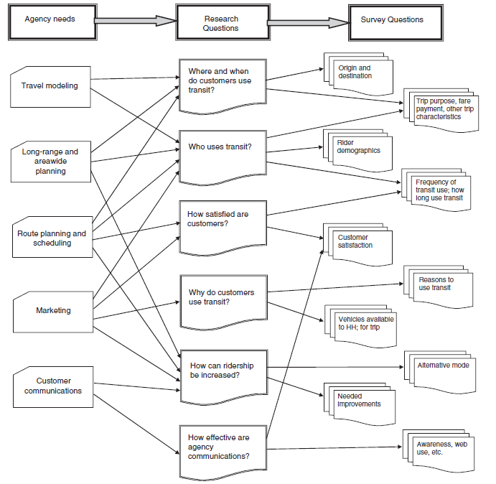
Translating Research into Survey Questions
TCRP Synthesis 63; page 19
Notes:
Transit agency needs turns into research that turns into actual questions.

Slide 19
Survey Instrument
How to write a good survey
Notes:
Note: specific wording is NOT standardized across transit agencies

Slide 20
Types of Questions
Closed-Ended
Dichotomous (2 answers, e.g. Yes/No)
Nominal (Categorical)
Ordinal (a.k.a. Likert, Ranking)
Filter/Contingency (Qualified)
Partially-Closed
Last answer is “Other______”
Open-Ended
Notes:
Dichotomous Questions: When a question has two possible responses, we consider it dichotomous. Surveys often use dichotomous questions that ask for a Yes/No, True/False or Agree/Disagree response.
Filter or Contingency Questions: Sometimes you have to ask the respondent one question in order to determine if they are qualified or experienced enough to answer a subsequent one. This requires using a filter or contingency question. For instance, you may want to ask one question if the respondent has ever ridden the NYCT bus and a different question if they have not (e.g., how many days per week do you ride the bus? Why don’t you ride the bus?). in this case, you would have to construct a filter question to determine whether they've ever ridden the bus
Closed ended questions are easy to code and analysis.
Open ended give respondents more freedom.

Slide 21
Do’s and Don’ts
Questions should be:
Concise (multiple choice)
Understandable
Useful
M.E.C.E. = Mutually Exclusive & Collectively Exhaustive
Questions should NOT be:
Double-barreled
Double negative
Technical jargon
Long-winded
Redundant
Obtrusive or embarrassing
Notes:
Mutually Exclusive: one and only one answer should apply.
Collectively Exhaustive: all possible answer choices are presented.
A double-barreled question is committed when someone asks a question that touches upon more than one issue yet allows only for one answer.

Slide 22
In-Class Exercise
Now, its time for you to practice

Slide 23
In-Class Exercise
1. How satisfied are you with the safety and cleanliness of CARTA buses?
Very Satisfied
Somewhat Satisfied
Neutral
Somewhat Dissatisfied
Very Dissatisfied
What is the primary flaw with question 1? How would you improve this question?
2. How useful do you find the information from CARTA’s Automated Vehicle Location system?
Very Useful
Somewhat Useful
Not Useful
N/A
What are some of the flaws with question 2? How would you improve this question?
3. Do you agree or disagree with the following statement? CARTA should not increase the frequency of bus service.
I agree
I disagree
What is the primary flaw with question 3? How would you improve this question?
4. Please indicate which of the following categories best describes your total household income?
$20,000 or less
$20,000 to $40,000
$40,000 to $60,000
$60,000 to $80,000
$80,000 to $100,000
$100,000 or more
What is the primary flaw with question 4? How would you improve this question?

Slide 24
Data Collection Plan
Putting it all together in order to create a…

Slide 25
Creating a Data Collection Plan
Determine research goals
Select survey mode & sampling methodology
Determine necessary sample size
Create detailed sampling plan
Draft questionnaire
Pre-test the questionnaire
Conduct staff training
Distribute survey & revise sampling plan
Code/process data & error check
Notes:
Emphasize the pre-test and then revise the questionnaire.

Slide 26
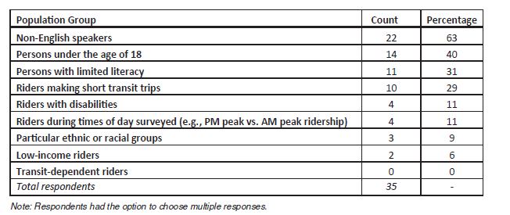
Other Considerations
Longitudinal comparisons
Consistency of questions with prior transit surveys
Underrepresented groups
Language (non-English speakers)
Those who cannot read/write
Others
TCRP Synthesis 138 page 36
Notes:
Those who cannot read/write on a transit vehicle because they get motion sick, etc.
TCRP Synthesis 138 – conducted a survey of 67 transit agencies and Metropolitan planning organizations (MPOs);
Asked about the surveys that they completed recently

Slide 27
Chicago Transit Authority
What does a (good) transit survey look like?

Slide 28
2016 Chicago Transit Authority Customer Satisfaction Survey
Objective: Comprehensive review of customer satisfaction conducted every two to three years
Content Included:
General travel behavior (modes, access/egress, etc.)
Fare payment types and media
Technology use (e.g., smartphones, email)
Demographics
Satisfaction (35 questions across 9 dimensions)
Comfort while riding; appearance; access to service; overall service; service delivery; information; communications on buses and trains; employee performance; personal safety
Source: https://www.rtachicago.org/sites/default/files/documents/plansandprograms/Regional-Transportation-Authority_-2016-Customer-Satisfaction-Study.pdf and http://www.transitchicago.com/assets/1/surveys/cssurvey2003.pdf

Slide 29
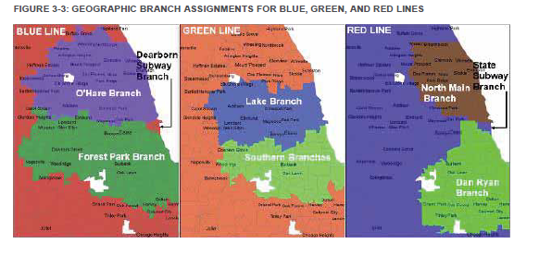
CTA: Mode & Sampling
Method
Onboard paper survey (distributed ~9,900 paper surveys)
Email recruitment for online survey (~60,000 email invitations)
Stratified Sampling
24 bus groups or rail lines (branch)
Sample Size
Minimum of 270 respondents per strata
Onboard paper survey responses: 949 (10% response rate)
Online survey responses: 7,959 (13% response rate)
Source: 2016 CTA Survey; page 35 and http://www.transitchicago.com/assets/1/surveys/cssurvey2003.pdf

Slide 30
CTA Online Questionnaire
2016 CTA Survey; page 33
Notes:
Satisfaction (35 questions across 9 dimensions) → Comfort while riding
Notice the 10-point Likert scale

Slide 31
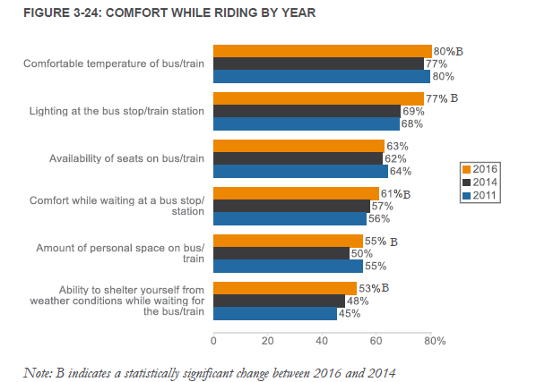
CTA: Results
2016 CTA Survey; page 52
Notes:
Overall satisfaction has increased since 1995.

Slide 32
Conclusion
Surveys are a good way for agencies to know who their riders are and what they want.
There are several survey types with varying costs, penetration and bias. They should be chosen to match their target.
Surveys should be easy to understand and should encourage participants to complete them.

Slide 33
Reference
Materials in this lecture were taken from:
TCRP Synthesis 63: On-board and Intercept Transit Survey Techniques
TCRP Synthesis 138: Public Transit Rider Origin-Destination Survey Methods and Technologies
CTA, Customer Satisfaction Survey, 2016.

