Slide 1
Lecture #3: Transit Data Types & Sources
[Course Instructor]
[Course Semester]
[Course Number]
Materials developed by C. Brakewood, K. Watkins, and J. LaMondia.

Slide 2
Outline: Transit Data Types and Sources
Types of transit data.
In-class exercise.
Manual data collection.
Automated data collection.
Comparison of service datasets.
Data sharing.

Slide 3
TYPES OF TRANSIT DATA
We need to quantify and characterize our systems with different
Notes:
We need accurate data to make appropriate decisions for transit service.

Slide 4
Three Main Types of Data
System Level Data
Entire operational overview
Useful for long-range planning, comparing service to similar regions
Route Level Data
Characteristics of specific routes
Useful for long-range planning, service planning, route optimization
Trip Level Data
Specific details of trips made on transit system
Useful for service planning, route optimization
Notes:
We need different types of quantify and characterize transit systems.
Routes versus trips - trips are referring to the passengers.

Slide 5
System Level: National Transit Database (NTD)
Established by Congress (Title 49 USC 5335a)
Primary source for statistics on transit in US
FTA grantees required to submit data
> 660 providers currently report to NTD
Data used to apportion > $5 billion FTA funds
Freely and publically available
https://www.transit.dot.gov/ntd
Notes:
The NTD was established by Congress (Title 49 USC 5335a). It’s the Nation’s primary source for statistics on transit in the USA.
Recipients of grants from the Federal Transit Administration (FTA) are required by statute to submit data.
Over 660 transit providers currently report to the NTD through the Internet-based reporting system.
NTD performance data are used to apportion over $5 billion of FTA funds to transit agencies.
The NTD is freely and publically available (download as an Excel spreadsheet)

Slide 6
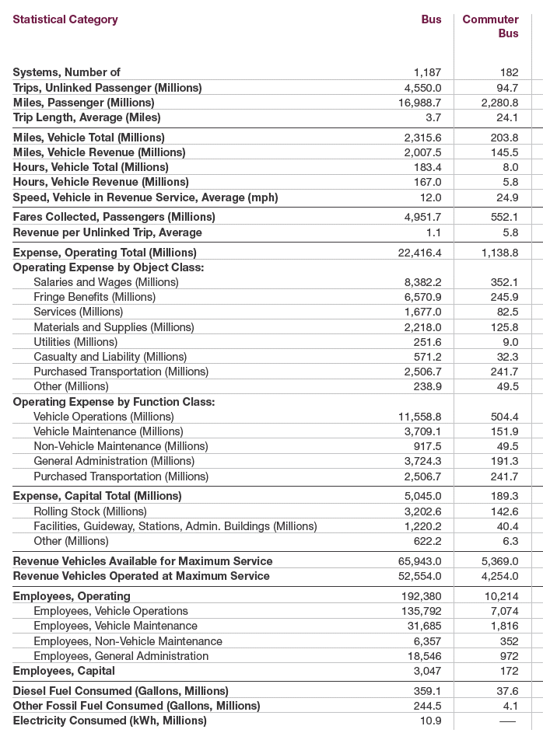
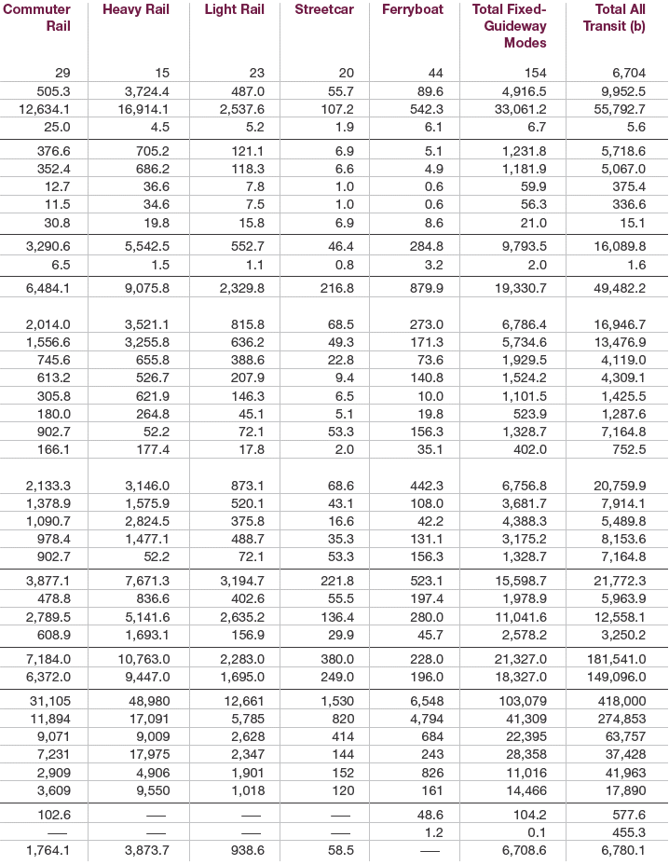
2018 National Transit Profile
Does this look familiar?
2020 APTA Fact Book – Page 4-5
Notes:
This is one of the primary data sources used to create the APTA Fact Book.
Note: The APTA Public Transportation Fact Book data differ from national total data reported in the NTD in two ways:
(1) Fact Book data are expanded to include all United States public transportation, while totals reported in the NTD are limited to summation of those systems reporting data in the NTD. E.g., Data from rural operators in the NTD is limited.
(2) The Fact Book reports some data collected by APTA surveys and not taken from the NTD.

Slide 7
What is in the NTD?
Modules include:
Financials (Fares/Funding)
Capital funds, operating expenses, operator wages
Transit Service (Supplied and Consumed)
Vehicle revenue miles, Vehicle revenue hours, unlinked passenger trips, passenger miles traveled
Safety and Security
Assets
Stations and maintenance facilities, transit way mileage, revenue vehicles
Resources
Number of employees, energy consumption
Notes:
Where are the funds coming from? Federal govt, local taxes, etc.
You can read about the rest by exploring the NTD on your own.

Slide 8
NTD Glossary (Expenses)
Capital Expenses = Purchase of Equipment
Useful life greater than one year and greater than $5,000
Includes Facilities (Guideway, Passenger Stations, Administration Buildings, Maintenance), Rolling Stock (Vehicles), other equipment
Operating Expenses = Operation of the Agency
Function (Vehicle Operations, Vehicle Maintenance, Non-Vehicle Maintenance, General Administration)
Object Class (Salary & Wages + Fringe= Compensation, Services, Materials and Supplies, Utilities, Casualty and Liability, Purchased Transportation, Other)
Notes:
NTD defines an employee as a person whose salary the agency reports under the Labor Object Class (Salaries and Wages).

Slide 9
NTD Glossary (Service Consumed)
Unlinked Passenger Trips = Boardings
Passenger Miles = Cumulative sum of the distances ridden by each passenger
Average Trip Length = Avg distance ridden = Passenger Miles / Unlinked Passenger Trips
Average Passenger Load = Avg number of passengers aboard a vehicle at any one time
Notes:
Unlinked Passenger Trips (UPT) is the number of boardings on public transportation vehicles during the fiscal year. Transit agencies must count passengers each time they board vehicles, no matter how many vehicles they use to travel from their origin to their destination. If a transit vehicle changes routes while passengers are onboard (interlining), transit agencies should not recount the passengers.

Slide 10
NTD Glossary (Service Supplied)
Average Speed = Miles / Hours in Revenue Service
Revenue Service = Operation when passengers can board and ride on the vehicle
Vehicle Total Miles = All miles from pull out to pull in, including "deadhead"
Vehicle Revenue Miles = Miles in Revenue Service
Vehicle Total Hours = Hours from pull out to pull in, including "deadhead"
Vehicle Revenue Hours = Hours in Revenue Service
Notes:
Revenue Service: does not include deadhead
Deadhead: The movement of a transit vehicle without passengers aboard.
There are two types of deadhead or non-revenue bus travel time:
(1) Bus travel to or from the garage and a terminus point where revenue service begins or ends;
(2) A bus’ travel between the end of service on one route to the beginning of another.

Slide 11
NTD Glossary (Service Supplied)
Revenue Vehicle = Vehicle in fleet available to operate in revenue service including spares and out for maintenance
Vehicles Available for Maximum Service = Number of vehicles an agency has available to operate revenue
Vehicles Operated Maximum Service = Largest number of vehicles operated at any one time
Base Period Requirement = Vehicles needed to serve the base (all-day) transit service
Peak-to-Base Ratio = Max Service / Base Period
Percent Spares = (Veh Available – Veh Operated) / Veh Available

Slide 12
NTD Performance Measures
Service Efficiency
Operating Expense per Vehicle Revenue Mile
Operating Expense per Vehicle Revenue Hour
Service Effectiveness
Operating Expense per Passenger Mile
Operating Expense per Unlinked Passenger Trip
Unlinked Passenger Trips per Vehicle Revenue Mile
Unlinked Passenger Trips per Vehicle Revenue Hour
Notes:
Efficiency versus Effectiveness
Efficiency – the relationship between service inputs and outputs (i.e., the cost to operate and the amount of service actually provided) – note that these do not involve the passenger.
→ This is the dollar per service output.
Effectiveness is generally the relationship between service inputs (i.e., the cost to operate) and service consumed (i.e., pax mile and trip).
→ This has the dollar per trip/pax mile, but also measures of the trip per service operated.
→ So, relationship of people versus cost as well as service operated
6 different metrics are shown for each agency.

Slide 13
In-Class Exercise
Work with the NTD.

Slide 14
Three Main Types of Data
System Level Data
Entire operational overview
Useful for long-range planning, comparing service to similar regions
Route Level Data
Characteristics of specific routes
Useful for long-range planning, service planning, route optimization
Trip Level Data
Specific details of trips made on transit system
Useful for service planning and route optimization
Notes:
We’ve talked about System Level Data from the NTD.
Now let’s talk about Route/ Trip Level Data.

Slide 15
Route and Trip Levels Are Similar
We describe routes and passenger trips with
Route/ Stop Locations
Route Scheduling
Volumes of Passengers
Access/ Egress Locations
Travel and Boarding Times
Trip Purposes
Two ways to collect this detailed data
Manual
Automatic
Exact Characteristics Depend on Application
Notes:
Route/ Stop location – Where is that route?
Route Scheduling – When do vehicles run on that route?
Volumes of Passengers – How many people are on the vehicle at any given time?
Access and egress refer to the exact location where the passenger trip began. Access from your home. Egress from the station to your work.
How long is your total travel time? Which vehicle did you board?
What is the purpose of your trip?

Slide 16
Manual Data collection
Planners & engineers can tailor route and trip analyses through

Slide 17
Manual Procedure Considerations
Instruments:
Pencil/paper
Hand-held units
Route Selection:
100 percent
Sample
Type of “Checks”:
Ride check: on-board the vehicle
Point checks: at a specific location
Surveys also used (at trip-level)

Slide 18
Ride Checks
Captures an entire route in detail
Data collection is done on-board
Checkers counts the number of boardings, alightings, & thru-passengers at each stop
Distance between each stop may also be recorded
Output: Route-level & Stop-level ridership data
Notes:
Can also determine peak load point along a route, etc.
Output is critical to service planning

Slide 19
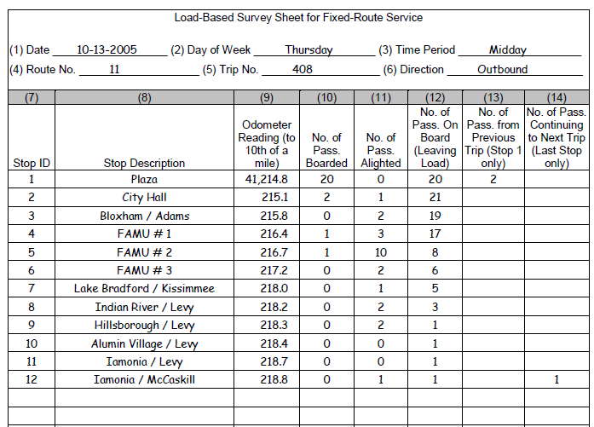
Ride Check Data Sheet - Example
Source: National Transit Database Sampling Manual (2009)
Notes:
For a single trip, which is defined as a one-way bus trip in revenue service (i.e., they are collecting fares). A round trip would count as two trips.
For each stop (unique number and name), count the passengers boarding, alighting, and those remaining on-board.
To determine passenger miles, use an odometer reading. Then, you can determine passenger miles based on the number of passenger on board times the distance between stops.

Slide 20
Ride Check - Basic Calculations
Total Unlinked Passenger Trips on the Route
= Sum of all Boardings
Load Profile for the Route
= Cumulative Boardings @ Stop – Cumulative Alightings @ Stop
Peak (maximum) load along the route
Average load along the route
Passenger Miles Traveled on the Route
= (Sum of Stop-Level Load) * (Distance between Stops)
Notes:
Calculate three types of metrics.
You will need to do all of these on the homework

Slide 21
Example Load Profile
Peak Load Point: 47 Pax
Average Load: 24 Pax
Image source: Candace Brakewood
Notes:
Calculate three types of metrics.

Slide 22
Point Checks
Data collection is done at one (or more) stops along a route
Number of passengers on the vehicle is recorded
Often conducted at high (peak) load points along a route

Slide 23
Surveys
Travel surveys are used to estimate complete origin-destination patterns
Questions include boarding location, alighting location, transfer location
Notes:
More in the next lecture

Slide 24
Source: TCRP Synthesis 63; Appendix page 78
Notes:
Example of TriMet’s Origin-destination survey

Slide 25
Source: TCRP Synthesis 63; Appendix page 78
Notes:
Example of TriMet’s Origin-destination survey

Slide 26
Automated Data collection
Transit operators are increasingly relying on new technologies for

Slide 27
Automated Data Sources
Automated Fare Collection (AFC)
Automated Passenger Counters (APC)
Automated Vehicle Location (AVL)
Archived data from AFC and AVL systems is an important byproduct of installing these systems.
Notes:
AFC is installed for fare collection (like smart card).
APC is generally installed on the vehicle with the primary purpose of data collection.
AVL is usually installed for real-time control and/or safety reasons. (GPS based).

Slide 28
Service Quality Improvement Cycles
Service Plan
Analyze Performance and Demand
Operational Control & Passenger Info
Transit Operation
Archive Data
Automated Data Gathering
Real-Time Loop
Off-Line Loop
TCRP Report 113, Chapter 1, page 9
Notes:
Automatically collected data can play two important roles in a transit agency’s service quality improvement process. As illustrated in the figure, there are two quality improvement cycles: one in real-time and one off-line.
In the real-time loop, automatically collected data drives operational control, aiding the transit agency in detecting and responding to deviations from the operational plan. It is also a source of real-time information that can be conveyed to customers using a variety of media.
In the off-line loop, automatically collected data that has been archived drives analyses that aid the transit agency in evaluating and improving its operational plan. Ultimately, good operational performance and high passenger satisfaction follow from having both a good operational plan and good operational control.

Slide 29
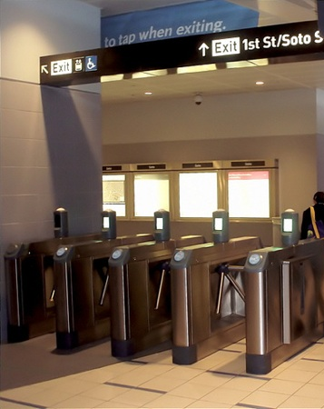
Automated Fare Collection (AFC)
Magnetic stripe & Smart Cards
Smart Card Systems have unique ID that provides entry (or exit) information at the individual level
Data not available in real-time (coming soon!)
Magnetic stripe and smart cards together can produce station/stop level data
Rail gate line counts
Bus fare boxes (operator often punches a key indicating other fare types, such as free passes)
Image source: http://www.flickriver.com/places/United+States/California/East+Los+Angeles/Brooklyn+Heights/
Notes:
AFC: Primarily smart card systems.
Important to produce station and stop level data.

Slide 30
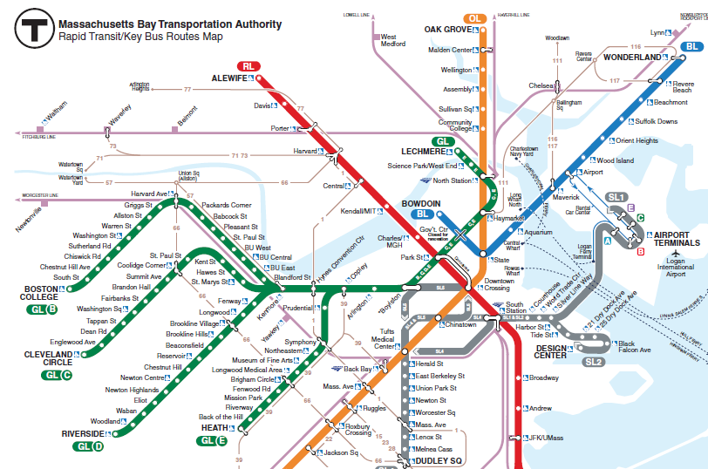
Smart Card Example: OD Estimation
AM Tap at Alewife
PM Tap at Kendall/MIT
AM Inbound trip: tap-in at “origin”
PM Outbound trip: tap-in at “destination”
Infer that passenger is traveling from Alewife Station to Kendall/MIT Station as a roundtrip

Slide 31
Automated Passenger Counters (APC)
Sensors near vehicle doors count passenger on and offs, usually using infrared beams.
Some vehicles also determine weight/steps on-board vehicle.
Typically, data not available in real-time.
Usually only on a sample (%) of bus fleet; redistribute buses to determine counts.
Source: http://www.cumtd.com/the-inside-lane/sampling-tests-automatic-passenger-counters
Notes:
APCs count passengers in two different ways. Infrared beams cross the stairwells at waist-high level. As passengers board and alight, the beams are broken (in a different order for boardings and alightings), and passenger activity is recorded (8).
Treadle mats are used in some systems. The mats are mounted to the vehicle steps and contain switches that close when the mat is stepped on. The transitions of closing and opening switches and the times between them determine passenger flows (6).
In certain climates, treadle mats can be difficult to maintain, but most observers report no difference in accuracy between the two technologies.

Slide 32
Automated Vehicle Location (AVL)
Originally, Signpost-beacon-based used to track the location of buses
Post-2000, GPS-based technology
Provided in real-time
Usually matched with schedule through Computer Aided Dispatch (CAD) systems
Also combined with other data sources (AFC & APC) to capture detailed ridership
Valuable for service planning (i.e., determining running times, schedule adherence)

Slide 33
Signpost-based AVL
Image source: King County Metro
Notes:
Older AVL-APC systems, like King County Metro’s, use a combination of beacons, which serve as fixed-point location devices, and dead reckoning for determining location between beacons, using the assumption that the bus is following a known route.
All transit coaches have electronic odometers, making it easy to integrate odometers into a location system. Route deviations present a problem for odometer-based dead reckoning, which is one of the reasons GPS is preferred. Some AVL systems include a gyroscope, which makes it possible to track a bus off-route using dead reckoning.
**Only picking up the location when the bus is near to the post**.
CTA was the first agency in the USA to use this, going back to the 1960s.

Slide 34
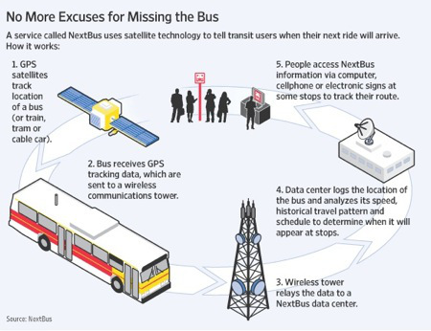
GPS-based AVL
Image source: nextbus.com
Notes:
In the last decade, the U.S. government’s global positioning system (GPS) has become the preferred location technology. GPS receivers on vehicles determine their location by triangulation based on signals received from orbiting satellites. Location accuracy for buses is generally better than 10 m, depending on the accuracy of clocks in the GPS receivers and on whether differential corrections are used.
Because GPS requires a line of sight to the satellites, GPS signals can be lost as buses pass through canyons, including man-made canyons caused by tall buildings. Tall buildings also reflect GPS signals, causing a phenomenon called multipath that can lead to erroneous location estimation. For example, on a GPS-driven map display, buses approaching Chicago’s Loop (downtown) appear to jump into Lake Michigan. In a system intended for real-time monitoring only, predictable errors such as this can be tolerated; however, for archived data intended for off-line analysis, errors like this pose a threat to data integrity. In tunnels and covered areas, GPS cannot be used unless repeaters are installed, as in NJ Transit’s Newark City Subway.

Slide 35
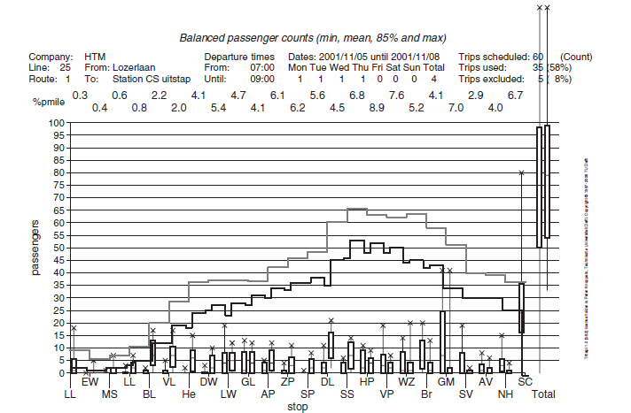
Combining AVL & APC
Detailed Route Level Analysis
Source: TCRP Report 113, page 37
Notes:
This shows how APC and AVL can be combined for a detailed route level analysis.
This shows not only mean loads → Black line
The upper, gray step function indicates 85th-percentile segment load
thus, adding the dimension of day-to-day variation.
This report has already pointed out the importance of extreme values of load for both passenger service quality monitoring and scheduling.
Also shown in the figure for each stop, as well as for the route as a whole, are box and whiskers plots of offs (just to the left of each stop) and ons. The box extends from the 15th percentile to the 85th percentile; a bar indicates the mean value; and the X above the box indicates the maximum observed value.
See page 37 of TCRP Report 113 for a detailed explanation.

Slide 36
Comparison OF Service DataSETS
Reference: TCRP Synthesis 153: The Transit Analyst Toolbox: Analysis and Approaches for Reporting, Communicating, and Examining Transit Data (2021)

Slide 37
Data Creation & Collection Tools for Transit Planning & Performance
Automated Vehicle Location (AVL)
Automate Passenger Counter (APC)
Automated Fare Collection (AFC)
SCADA/CAD systems – Supervisory control and data acquisition (SCADA) for rail & computer aided dispatch (CAD) for bus & ferry systems collect data on fleets & monitor information of individual vehicles relative to other vehicles
Scheduling – uses stop locations, planned trips, & vehicle & operator work to provide planned work by which operations is measured
Notes:
TCRP 153 Pg. 10

Slide 38
Transit Systems & Service Data Use & Generation
Source: TCRP Report 113, page 11
Notes:
The systems that use (input) specific service data sets to generate (output) useful information are shown in Table 1. The table shows the dependency of deriving good information for “downstream” systems that use the information.

Slide 39
Static Service Data by Mode
TCRP 153 Pg. 28
Notes:
Static data sets—all agencies generate the static data sets—schedules, stops, and special event schedules (see Figure 6).
A survey of 28 agencies on general agency organization, data collection techniques, service data and performance metrics, data governance, data management, data curation, data tools, and improvement needs.

Slide 40
Real Time Data Collected by Mode
TCRP 153 Pg. 29
Notes:
Real-time Data Sets—as reported by the survey, all agencies collect travel times, events, and ridership information; some collect other data such as passenger wait times and dwell times.
Figure 7 shows the results from the survey. The real-time raw data include the following:
• Travel times—describes amount of time to travel from origin to destination for a transit revenue trip.
• Travel events—describes an event that occurs along a revenue trip such as time and location of the arrival or departure from a stop.
• (Passenger) wait times—describes the average time a passenger waits at a pickup place (e.g., stop) for transit service.
• Dwell times—describes the time a transit vehicle in revenue service stays at a stop to drop off and pick up passengers.
• Boardings and alightings at each stop by trip—the number of passengers who board and alight a transit vehicle in revenue service at each stop for each trip. Data derived from raw boardings/ alighting produce passenger loads and ridership information

Slide 41
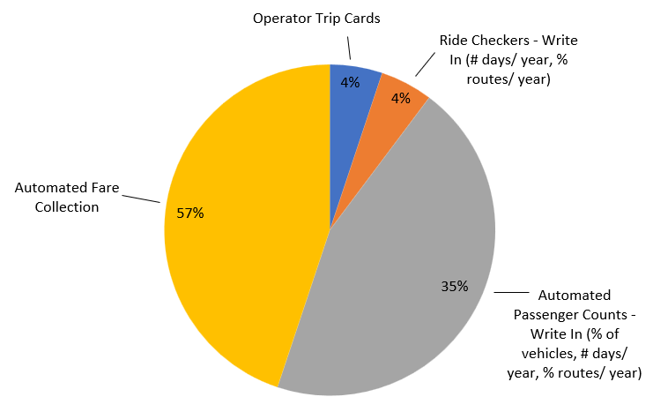
Bus Ridership Data Sources
Figure 9. Primary Sources for Bus Mode Ridership
TCRP 153 Pg. 32
Notes:
For bus ridership, most agencies use AFC to collect ridership data (57%). Only 35% use APC.
Most respondents from bus modes collect ridership information from automated fare collection systems (at 57%) as shown in Figure 9. Only 35% collect ridership information from APCs. Of the respondents that collect using APCs, the system is deployed in the majority of their fleet (65% to 100%; see details in Appendix B). Few agencies use manual techniques such as operator trip cards or rider checkers for their primary ridership data

Slide 42
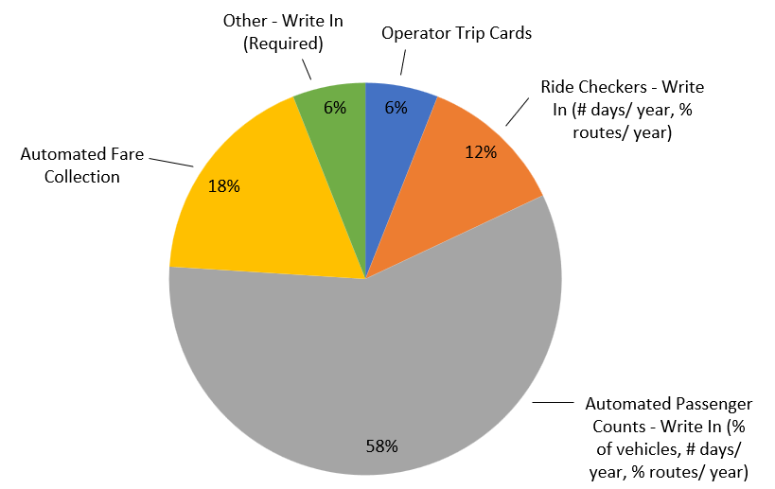
Rail Ridership Data Sources
Figure 11. Primary Sources for Rail Mode Ridership
TCRP 153 Pg. 32
Notes:
For rail ridership, APCs are the most commonly used and AFCs are ranked 2nd.
Many agencies use a secondary set of data to validate or supplement their bus ridership information as shown in Figure 11. In the case of the alternative or supplemental methods, APCs ranked the highest with 52% use. Manual methods such as ride checkers and operator trip cards also ranked higher. Another method mentioned is the use of “video of onboard cameras to validate APC counts.”

Slide 43
Data Collection Challenges
Figure 11. Primary Sources for Rail Mode Ridership
TCRP 153 Pg. 34
Notes:
The survey differentiated challenges to data collection from data management and curation. The purpose was to differentiate the tools used to collect the data from the processes used to clean, integrate, store, and provide access to the data. Question 47 asked respondents to rank data collection processes (see Figure 13), and Questions 47 and 48 asked about data collection challenges and examples of challenges (see Table 4)

Slide 44
Data Sharing
Reference: TCRP Report 213: Data Sharing Guidance for Public Transit Agencies Now and in the Future (2020)

Slide 45
Transit Data Types & Sharing Characteristics
TCRP 213 Pg. 6 – 8
Notes:
Figure 1 summarizes the sharing characteristics of the major public transit data types, based on the literature review and transit agency interviews. Public transit data can be classified into two broad categories: (1) data pertaining to passengers and (2) data pertaining to the public transit system itself. One exception is incident data, because incidents may involve passengers as well as infrastructure, vehicles, and transit agency staff.
Data pertaining to passengers includes passenger count data and survey data as well as newer data types, such as fare or bank card transactions, video, Wi-Fi, Bluetooth, and app and webpage usage data. Most (but not all) types of passenger data contain records of individual passengers or records pertaining to a specific card or device that has the potential to identify an individual. This is a critical distinction for data sharing, because the sharing of individual records poses a privacy risk.
Data pertaining to the transit system includes route and schedule data, vehicle location data, maintenance, staff and operations data, and financial data. These data types typically do not contain privacy risks; however, there may be security risks associated with the sharing of some of these data types. Although security was not raised as an issue by the majority of the transit agency interviewees for this study, a few interviewees indicated that their agencies refrained from sharing some detailed transit system and transit system usage (passenger) data because of concerns that it could be used to stage an attack on public transit infrastructure and the people who use it.

Slide 46
Methods for Sharing Data
Static Reports
Interactive Dashboards
Data Repositories
Developer APIs
Accessible to all audiences
Protect against misinterpretation of data
All audiences can interact with the data
Researchers and innovators can download and manipulate, generating new analysis and insights
Developers can efficiently pull data into apps
Data cannot be manipulated
If underlying data is not downloadable, data manipulation is limited
Dashboards require significant effort to develop
Difficult to use for nontechnical audiences
Risk of data misuse
Not appropriate for disaggregate data on individuals
Only appropriate for data sources that man developers want to access at frequent intervals
Increasing Interactivity
Figure 6. Methods for Sharing Data Online
TCRP 213 Pg. 37 – 38
Notes:
Transit agencies share data publicly in a variety of forms. All the transit agency interviewees indicated their agencies have data and reports that can be downloaded from their websites. In addition, two have interactive dashboards that allow users to interact with the data in a controlled way. Most of the transit agencies share route, schedule, and vehicle location data using an API, which is essentially a set of methods for retrieving data that makes it easy for developers to use the data. These formats have advantages and disadvantages, as shown in Figure 6.

Slide 47
SharedStreets Initiative
The National Association of City Transportation Officials (NACTO) launched the SharedStreets initiative in 2018 which provides open-source software tools to public entities and private companies to manage and share data about physical infrastructure and vehicle activity.
Standardizes data on physical infrastructure and vehicle activity
Builds open-source tools
Anonymizes sensitive data on individuals
Platform for collaboration and trust
https://sharedstreets.io/
TCRP 213 Pg. 39
Notes:
NACTO is starting to standardize data sets and provide open-source tools across cities and across transportation networks.

Slide 48
Future Trends
Increasing use of automated data collection systems
Including mixed modes (manual & automated)
More disaggregate data used for planning and decision-making (refined units of analysis)
Increasingly common for transit agencies to share data, particularly in standardized formats
Notes:
Still some manual data, and although new devices allow big data collection, it is challenging to work with in some cases.
New data sets are increasingly common to provide openly.

Slide 49
Conclusions
We need accurate data to make appropriate decisions for transit service.
The National Transit Database (NTD) is the largest source of system-level transit data in the US.
Manual data collection consists in recording transit information in person.
Automatic data collection uses new technologies in buses to record vehicle location, vehicle loads, etc. These new technologies are becoming increasingly common.

Slide 50
References
Materials in this lecture were taken from:
Walker, J. (2011). Human transit: How clearer thinking about public transit can enrich our communities and our lives. Island Press.
TCRP Report 113. Using Archived AVL-APC Data to Improve Transit
Performance and Management (2006)
National Transit Database Sampling Manual (2009)
Worldwide, Wirthlin, and T. C. R. P. FJCandN. "Report 63: Enhancing the Visibility and Image of Transit in the United States and Canada." Transit Cooperative Research Program, National Research Council, Washington, DC (2000).
"Sampling Tests Automatic Passenger Counters." The Inside Lane. N.p., n.d. Web. 11 Sept. 2014.
TCRP Synthesis 153: The Transit Analyst Toolbox: Analysis and Approaches for Reporting, Communicating, and Examining Transit Data (2021)
TCRP Report 213: Data Sharing Guidance for Public Transit Agencies Now and in the Future (2020)

