Slide 1
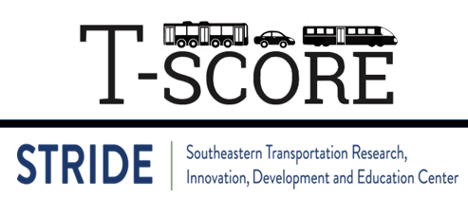
Lecture #22: Regulation & Finance
[Course Instructor]
[Course Semester]
[Course Number]
Materials developed by C. Brakewood, K. Watkins, and J. LaMondia.

Slide 2
Outline
Overview of transit regulation
Government role in funding
Local funding options
Federal grant programs
How to prioritize investments

Slide 3
Transit regulation
No required reading

Slide 4
Some Reasons for Government Involvement
Socially important but financially non-remunerative service
Support for lightly used suburban areas
Avoidance of profit-gouging monopolies
Minimal duplicative, uncoordinated services
Ensure safety of the traveling public and the other potentially affected parties
Notes:
Transportation in general needs control from the government for these reasons. It impacts social, economic, etc. aspects of our lives.
If we didn’t have controls in place, service would be horrible – see bullet points
Talk about how each is good now, but would be horrible if left solely to for-profit agencies
Social Service - Provide certain levels of mobility and special services for population groups/ geographic areas/ types of trips/ etc.
Also: Specialty programs. E.g, Reduced fares for students/ elderly
Fares - Protect public from being overcharged
Other: Minimum impacts - Noise & air pollution
Evacuation procedures/ Fire protection

Slide 5
Public Takeovers
In the United States, most transit service was originally privately provided but faced many challenges
Public need ≠ capital gains
Opposition from auto-industry
Public consolidation of agencies
Notes:
In the past, transit was solely private industry, but this is actually its downfall
It ate itself up
A big part of this was the government organizing multiple agencies together and coordinating efforts

Slide 6
Integrating Transit
Many agencies remained uncoordinated, fragmented until the 1950s/1960s
Major effort within public ownership is to coordinate systems
Example 1: New York City
In 1940, the BMT and IRT (private companies) were taken over by the City of New York's Board of Transportation (BoT)
In 1953, the New York City Transit Authority, now known to the public as MTA New York City Transit, succeeded the BoT.
Example 2: Nashville
In 1926, motor buses were first introduced in Nashville to supplement the existing street railway service. The Tennessee Electric Power Company took over the controlling interest of the public transportation system in 1930, and in 1940-41 phased out Nashville's streetcar system.
1973, a transfer from private to public ownership was completed and the Metropolitan Transit Authority was officially chartered.
http://www.nashvillemta.org/Nashville-MTA-history.asp
Notes:
Integrating transit systems- lots of modes all coordinated!!
Regulation helped with coordination
A lot of regulations apply to this
In 1940, the BMT and IRT systems were taken over by the City of New York's Board of Transportation, which already operated the IND system
The New York City Transit Authority, a public authority presided by New York City, was created in 1953 to take over subway, bus, and streetcar operations from the city,[7] and placed under control of the state-level Metropolitan Transportation Authority in 1968

Slide 7
Types of Ownership Today (1/3)
Private Companies
Typically in small communities
Receive indirect or direct financial assistance from government
Often hired as contractors to operate systems
Source: Vuchic, 2007, page 435
Notes:
Three main types of ownership today... All with different regulations, what can and cannot accomplish!
Some private companies, in order to be cost effective, only deal with small areas. More common in Europe/ Asia (e.g., in Hong Kong and Japanese cities)

Slide 8
Types of Ownership Today (2/3)
City Area Public Agencies
Typically in small-medium sized communities
Receive direct government funds
Several forms:
Quasi-private company
Utility division
Municipal agency
Source: Vuchic, 2007, page 435
Notes:
This is most common in the US.
A quasi-private company uses shareholders and is really common in Europe – particularly Germany.
A utility division is common in small us cities where the electric company, or some other utility, of the city organizes the transit service – this is not common anymore.
The municipal agency means that it is under the umbrella of the local government – this is part of the city government – difficult as cities grow into regions.
Each category has pros and cons, for example, quasi-private is able to do much more unique things because they only report to shareholders; whereas the municipal agency is responsible to the voters.

Slide 9
Types of Ownership Today (3/3)
Regional Transit Agencies
Typically in large mega-regions
Serve inter-city travel routes
Several forms:
County-owned transit agency
Regional transit authority (e.g., NYCT, WMATA, SEPTA)
Regional transit district (e.g., BART in San Francisco)
State-owned transit agency (e.g., NJ Transit, MTA in Maryland)
Source: Vuchic, 2007, page 436
Notes:
Cities are evolving into regions, this is a common approach in many areas, particularly for mega regions.
County-owned transit agency – founded and owned by one or several counties because it serves them all.
Regional transit authority – organization setup by state legislation, usually operate entire transit systems
**THIS IS NYCT**
Regional transit district – similar to an authority but must be approved by voter referendum and it may have taxing power!
Example of transit district: San Francisco Bay Area Rapid Transit District; also, Albany, NY.
State-owned transit agency – best for small states that organize everything, typically within DOT.
Bottom line: In the US, Major metropolitan areas have regional transit authorities (public organization).

Slide 10
Arguments for deregulation
Pro Deregulation
Regulations are inefficient and wasteful
Takes too much red-tape for development
Others
Anti Deregulation
Social needs of underprivileged travelers
Support allows for economic vitality
Others
Notes:
* Ask students what they think of regulations. Should we deregulate?

Slide 11
Sources of Transit Funding
Sources: T4America’s Thinking Outside the Farebox &
Vuchic’s Urban Transit (2005)

Slide 12
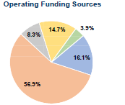
Funding from Fares
Farebox recovery ratio is the fraction of operating expenses that are met by the fares paid by passengers
Typical farebox recovery ~ 30-40%
Nashville’s MTA – 2016 Numbers:
Total Fare Revenue
=
Total Operating Expenses
Image source: NTD
Notes:
This is what users pay.
If farebox is only covering a small percentage of the operating costs, where does the rest of the money come from to operate and build transit service?
Other funds are local, state and federal subsidies.
[* Consider adding information from a transit agency near you]

Slide 13
Role of the Government in Funding
Federal: primary role is supporting the construction and expansion of transit systems through competitive grant funding.
State: generally have a limited role in funding
New York is an exception (along with California, Massachusetts, Pennsylvania and a few others)
Local: have a wide range of revenue options, such as sales taxes.
Source: T4 America, page 22
Notes:
Feds – mainly support large capital projects (some limited role in operating expenses)
The New York State government provides more public transit funding than any other state government, about $3 billion annually. This fact is not surprising as New York state transit systems carry about 33% of all transit riders in the country. Of course, the vast majority of these riders are in the New York City metropolitan area.
State Transit Operations Assistance (STOA) fund, first inaugurated in 1975 and funded with general funding. This funding, also known as section 18-b funding, requires a 100% local match to receive and accounts for about $224 million of the total of $3 billion. Second, the Mass Transit Operating Assistance (MTOA) fund was started in 1981 and is divided into two sections: downstate, which is the New York City metropolitan area, and upstate, which is everything else.
Local governments have a wide range of revenue options, such as sales taxes, special assessments, parking and car rental fees, tax increment financing, and property taxes. These revenues can be applied directly to project costs or used to as a repayment stream either for municipal bonds or private investment. Often, though, these funds are dedicated to operating and maintaining existing transit service and roads, leaving little or no surplus that can be used for new transit capital projects.

Slide 14
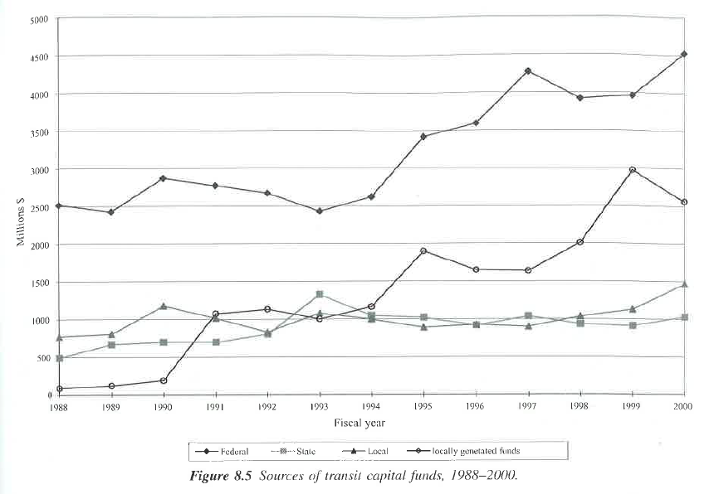
Sources of Capital Funds for Transit
Source: Vuchic, 2007, page 423
Notes:
Sources of capital funds for transit: largest in terms absolute provider is the federal government.
Largest is from federal sources, local now outweighs state.
Locally generated funds are increasing – these includes local taxation and other contributions

Slide 15
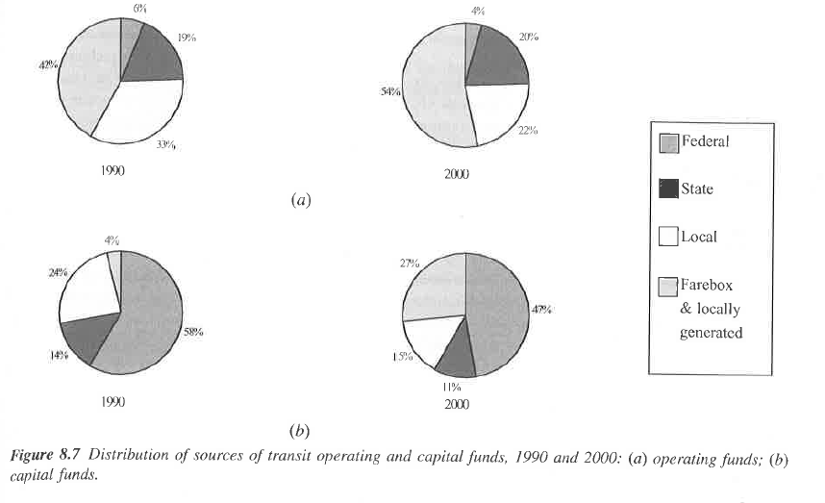
Distribution of Sources of Funds
Operating
Capital
Source: Vuchic, 2007, page 425
Notes:
A) groups represent operating funds – local dominated (particularly by farebox and other locally generated revenue)
B) groups represent capital investment funds – federal dominated (dominance of federal funding in capital)
1990 on the left; 2000 on the right

Slide 16
Local Funding
Sources: Litman’s Local Funding Options for Public Transportation &
TCRP Report 129: Local & Regional Funding Mechanisms for Public Transportation
Notes:
This report evaluates eighteen potential local funding options suitable to help finance public transit or other transportation projects and services. They are evaluated according to eight criteria, including potential revenue, predictability and sustainability, horizontal and vertical equity, travel impacts, strategic development objectives, public acceptance and ease of implementation.

Slide 17
2005 NTD Data
Nearly $26 billion was available for transit from local and regional sources ($6 billion for capital improvements and $20 billion for operations), including:
Fares and other earned income accounted for ~51% of revenue, and virtually all of these funds are used for operations.
Local dedicated sources accounted for ~18% of revenue and came from the following:
Sales taxes (57.5%), Property taxes (5.8%), Gas taxes (3.8%), Income taxes (2.0%), Tolls (2.0%), and Other (28.8%).
Directly generated taxes accounted for a ~16% of revenue and came from the following:
Sales taxes (45.5%), Property taxes (7.0%), Tolls (5.0%), Gas taxes (0.2%), and Other (42.1%).
Local general funds accounted for ~10% of revenues.
Other local sources accounted for ~5% of revenues.
Source: TCRP Report 129, pages 3-4
Notes:
Funds Dedicated to Transit at their Source: Any funds raised specifically for transit purposes, and which are dedicated at their source, rather than an appropriation of general funds. These funds include:
Dedicated taxes
Bridges
tunnels and highway tolls
Bonds and loans
Other dedicated funds.
Directly Generated Funds: Any funds where revenues are generated by or donated directly to the transit agency, including:
Passenger fare revenues
Advertising revenues
Donations
Bond proceeds
Taxes imposed by the transit agency.
Funds Allocated to Transit out of General Revenues of the Government Entity: Any funds allocated to transit out of the general revenues of the governmental entity. General revenue funds are usually determined through a state or local government's annual budgeting process.

Slide 18
Options for Local/Regional Transit Funding
Note: Funding categories also include financing mechanisms and farebox revenue.
Source: Litman page 4 & TCRP Report 129
Notes:
Traditional tax- and fee-based transit funding sources. These include all traditional forms of broad-based tax- and fee-based and related revenue-raising mechanisms that have been available or used for transit capital investment or to support transit operations since transit began to be transformed from a private business into a public service in the 1960s. These “traditional” sources include those for which there is generally a direct and broadly accepted logic for making expenditures on transportation, including transit.
Common business, activity, and related funding sources. This category of funding sources includes broad-based but somewhat less widely employed taxing and revenue-raising mechanisms that are used to support transit in various settings. The use of these revenue-raising mechanisms represents, in part, a recognition that funding public transportation is a broad responsibility and that meeting this responsibility requires contributions of funds from sources whose yield is significant and whose participation is politically acceptable.
Revenue streams from projects. This category includes various arrangements that can be used to capture revenue primarily from the income streams of private business and related development activities benefiting from proximity to specific transit facilities and services. These include
New “user” or “market-based” funding sources. Expanded tolling, congestion pricing, emission fees, and vehicle miles of travel (VMT) fees applied at the local and/or regional level have become the subject of greatly expanded research and analysis; however, implementation has been limited and revenue flows to transit rare, with the possible exception of “toll credits” used as a local match based on state authority.
Note: this does not include financing

Slide 19
Type 1: Traditional tax- and fee-based transit funding sources (1/2)
This category includes all traditional forms of broad tax- and fee-based revenue-raising mechanisms, including:
Sales taxes can be collected from the retail sales of certain tangible personal property and services. These are the most widely used source of dedicated local/regional funding.
All but five states have state sales taxes with rates ranging from 4% to 7.25%. At the local/regional level, additional sales taxes enacted for transit typically range from 0.25% to 1%
Property taxes or ad valorem taxes on land and building value are generally the principal source of revenue for local governments. Portions of local property taxes are commonly used by special districts and authorities, including transit authorities and school districts.
TCRP Report 129, page 16
Notes:
Traditional tax- and fee-based transit funding sources. These include all traditional forms of broad-based tax- and fee-based and related revenue-raising mechanisms that have been available or used for transit capital investment or to support transit operations since transit began to be transformed from a private business into a public service in the 1960s. These “traditional” sources include those for which there is generally a direct and broadly accepted logic for making expenditures on transportation, including transit.
General revenues/funds serve as a resource to support any and all public purposes. They are from any number of local and regional sources.
Sales taxes are the most widely used source of dedicated local and regional funding for transit. Generally, sales taxes provide the greatest yield and stability as well as being among the most broadly acceptable sources of funding for public transportation.

Slide 20
Type 1: Traditional tax- and fee-based transit funding sources (1/2)
3. Lease Revenues: Transit systems may generate income through leasing (at market rates) portions of physical facilities, typically terminal, station, transfer, or parking facilities.
4. Advertising: Most transit agencies solicit and accept advertising on their vehicles, facilities (such as stations and shelters), and materials (such as tickets, schedules, and maps).
5. Concessions: Larger transit agencies with significant space in terminal and station facilities may enter into concession agreements (an income-generating strategy similar to leasing) with a variety of commercial and retail enterprises.
These include newsstands, food stands, ATMs, vending machine operations, shops, etc.
TCRP Report 129, page 18
Notes:
Not talking about:
Contract or Purchase-of-Service Revenues: Transit systems often provide transportation services in addition to their regularly scheduled services for which revenues are received based on agreed-upon levels of service and rates. Municipal government, individual businesses and industries, health and social service agencies, and educational institutions may purchase transit services.
Vehicle Fees: A variety of fees are charged to vehicle owners and operators by state governments. These fees are based on vehicle value, weight, and/or age. The fees are charged for issuance of titles, licenses, registration, and/or inspection.

Slide 21
Type 2: Common business, activity, and related funding sources
These are somewhat less widely used to support transit, including:
Employer/payroll taxes are typically imposed directly on the employer for the amount of gross payroll paid for services performed within the transit district. Employer taxes are usually administered by the state revenue agency on behalf of the transit agencies.
Parking revenues can come from surface lots and structured parking facilities that the transit agency own.
Rental car taxes are paid by the consumer on the rental of a passenger car for a specified period of time and typically go to state revenue departments. They may be reallocated back to local governments or agencies, including public transportation. Rates typically range from 1 to 2 percent.
TCRP Report 129, page 19
Notes:
Common business, activity, and related funding sources. This category of funding sources includes broad-based but somewhat less widely employed taxing and revenue-raising mechanisms that are used to support transit in various settings. The use of these revenue-raising mechanisms represents, in part, a recognition that funding public transportation is a broad responsibility and that meeting this responsibility requires contributions of funds from sources whose yield is significant and whose participation is politically acceptable.
Rental car taxes are paid by the consumer on the rental of a passenger car for a specified period of time and typically go to state revenue departments. They may be reallocated back to local governments or agencies, including public transportation. Rates typically range from 1 to 2 percent.
Example: In 2007, Allegheny County in Pennsylvania (Pittsburgh) enacted a $2 rental car fee to support Port Authority Transit Services.

Slide 22
Type 3: Revenue streams from projects
This category includes arrangements to capture revenue from the income streams of private business and development activities benefiting from proximity to transit facilities/services, including:
Value Capture refers to circumstances in which the provision of public transportation increases the market value of surrounding real estate, and measures are enacted to capture some or all of that increase to defray public expense.
Right-of-Way Leasing: Linear rights-of-way owned and maintained by transit agencies providing fixed guideway services have the potential to serve a number of emerging private business needs.
Example: cable and fiber-optic networks
TCRP Report 129, page 28 & 30
Notes:
Revenue streams from projects. This category includes various arrangements that can be used to capture revenue primarily from the income streams of private business and related development activities benefiting from proximity to specific transit facilities and services. These include the most common value capture mechanism is the general real property tax, with no special features other than regular assessment of market value; this is because the common real estate tax includes the less known land value tax. Types of value capture include the following:
Land value tax (LVT)
Tax-increment financing (TIF)
Special assessment districts or improvement districts

Slide 23
Type 4: New “user” or “market-based” funding sources
This category includes emerging revenue sources that are intended to vary based on market forces.
Tolls are charged on a specific piece of transportation infrastructure to raise revenue (and influence demand).
Congestion charging is a pricing road, bridge, or tunnel based on the volume of traffic and/or level of congestion being experienced.
Vehicle Miles Traveled (VMT) fee is a policy of charging motorists based on how many miles they have traveled.
TCRP Report 129, page 31
Notes:
New “user” or “market-based” funding sources. Expanded tolling, congestion pricing, emission fees, and vehicle miles of travel (VMT) fees applied at the local and/or regional level have become the subject of greatly expanded research and analysis; however, implementation has been limited and revenue flows to transit rare, with the possible exception of “toll credits” used as a local match based on state authority.
Note: this does not include financing

Slide 24
Federal Funding
Source: Federal Transit Administration: http://www.fta.dot.gov/
Note: this content may have changed with the 2021 infrastructure bill.
Notes:
How FTA plays a role in providing money to transit agencies.
Note: this content may have changed with the 2021 infrastructure bill. UPDATE ???

Slide 25
When do the feds provide funds?
Typically, the project has one or more of the following qualities:
National significance (not just local benefits)
Interstate characteristics (more than 1 area/state)
Major investment of a permanent facility with long-term significance (can pool together funds)
Project has large, positive, non-quantifiable externalities
Research/demonstration activities that benefit the country (could be used in other areas)
Strong political support at the national level
Source: Vuchic (2007), page 411
Notes:
Transit projects:
Number 1 – economic impacts are usually an important justification.
Numbers 3 & 4 are most common.

Slide 26
Current Federal Legislation and Funding
Fixing America’s Surface Transportation Act (FAST Act): signed into law by President Obama on December 4, 2015
The president’s FY 2017 budget for the DOT is $98.1 million, including 19.8 million for the FTA
https://www.transportation.gov/sites/dot.gov/files/docs/DOT_BH2017_508%5B2%5D.pdf
Notes:
The Infrastructure Investment and Jobs Act (IIJA) was passed by Congress in fall 2021. This information may need to be updated.

Slide 27
Capital Investment Program
FTA’s primary grant program for funding major transit capital investments, including heavy rail, commuter rail, light rail, streetcars, and bus rapid transit.
Discretionary grant program. Instead of an annual call for applications and selection of awardees by the Federal Transit Administration (FTA), the law requires that projects seeking CIG funding complete a series of steps over several years to be eligible for funding.
New Starts, Small Starts and Core Capacity Improvements
Source: https://www.transit.dot.gov/funding/grant-programs/capital-investments/capital-investment-grant-program
Notes:
There are other programs for transit funding, this presentation will just focus on these.
Agencies will have to apply for this with multiple steps over several years. (Detail on next slide)

Slide 28
New Starts, Small Starts & Core Capacity
New Starts Projects are new fixed guideway projects or extensions to existing fixed guideway systems with a total estimated capital cost of $300 million or more or that are seeking $100 million or more in Section 5309 CIG program funds.
FAST specifies that New Starts projects are limited to a maximum Section 5309 CIG program share of 60 percent. The maximum Federal contribution from all Federal sources to a New Starts project is 80 percent.
Small Starts Projects are new fixed guideway projects, extensions to existing fixed guideway systems, or corridor-based bus rapid transit projects with a total estimated capital cost of less than $300 million and that are seeking less than $100 million in Section 5309 CIG program funds.
Maximum CIG share is 80 percent. Total Federal funds may not exceed 80 percent.
Core Capacity Projects are substantial corridor-based capital investments in existing fixed guideway systems that increase capacity by not less than 10 percent in corridors that are at capacity today or will be in five years.
Maximum Section 5309 CIG share is 80 percent. Total Federal funds may not exceed 80 percent.
https://www.transit.dot.gov/sites/fta.dot.gov/files/docs/5309_Capital_Investment_Grant_Fact_Sheet.pdf
Notes:
4th option - Programs of Interrelated Projects are comprised of any combination of two or more New Starts, Small Starts, or Core Capacity projects. The projects in the program must have logical connectivity to one another and all must begin construction within a reasonable timeframe.

Slide 29
Project Development Process
https://www.transit.dot.gov/funding/grant-programs/capital-investments/project-development-process-map-21-cig-program-0
Notes:
Small starts - More streamlined, basically steps 1 and 2 are combined from the New Starts Process.

Slide 30
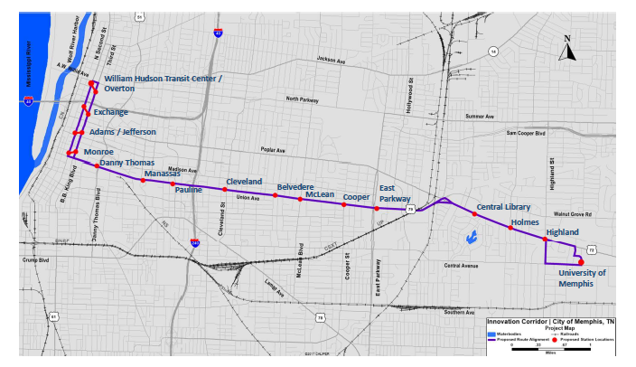
Current New Starts, Small Starts & Core Capacity Projects
There is one current project in Tennessee (Memphis Innovation Corridor Project).
https://www.transit.dot.gov/funding/grant-programs/capital-investments/current-capital-investment-grant-cig-projects
Notes:
[* Consider adding information from a transit agency near you]

Slide 31
How Can Local Decision-makers Prioritize Investments?
TCRP Report 227: Prioritization of Public Transportation Investments: A Guide for Decision-Makers (2021)

Slide 32
Context and Challenge
Increased emphasis on metrics-based prioritization to support funding decisions
Transit projects are often at a disadvantage, particularly in a multimodal context, because they have benefits that are either difficult to quantify or that have traditionally been inadequately addressed by methods developed with highway capacity projects in mind
Serve Diverse Communities
Capture Transit Benefits
Provide Realistic Approaches
Actionable Recommendations to Advance the State of Practice
Source: EBP, TCRP Report 227
Notes:
Transit projects are often at a disadvantage when compared to projects with other modes because benefits are hard to quantify.

Slide 33
Transit investments target more than one goal
Effective transit prioritization will address the full range of transit investment benefits.
Traditional Traveler Benefits
Travel Time & Reliability for Transit Users
Travel Cost (Affordability)
Wider Benefits for Society
Accessibility
Economic Impacts
System Stewardship
Congestion Reduction for Road Users
Safety and Security
Environmental Quality
Public Health and Quality-of-Life
Regional Integration and Coordination
Cost Effectiveness / System Preservation
Project Viability / Feasibility
Land Use Compatibility
Social Equity / Environmental Justice
Source: EBP, TCRP Report 227

Slide 34
TCRP Guidebook focuses on prioritization of capital investments
Capital funds:
Significant federal share
Governed by LRTPs, TIPs/STIPs
Varying levels of coordination between transit operators, MPOs, DOTs
More likely to be evaluated and prioritized in a multimodal context
Operating funds:
Largely locally funded
Generally considered the purview of transit operators
Source: APTA 2020, data on transit funding from 2018
Source: EBP, TCRP Report 227
Notes:
2018 Data – total sources of funds

Slide 35
Attributes of successful prioritization practice, generally
The TCRP guidebook builds from existing best practice for multimodal prioritization…
Carefully define investment objectives
Measure progress toward objectives
Leverage benefit-cost framework to compare among objectives, scale relative to cost
Integrate qualitative approaches for objectives that are important but not easily quantified
Context matters – consider the decisions that are to be informed, types of investments, timeframe, available data
Work toward structure, repeatability, and accountability to stakeholders
…while also recognizing what makes transit unique.
Source: EBP, TCRP Report 227
Notes:
Qualitative approaches (e.g., equity)

Slide 36
Guidance on choosing criteria for the situation
The TCRP guidebook provides recommendations organized by five illustrative “archetypes”
Basic Access
Large Legacy System
Statewide
Growing Transit
Small Fixed Route
Focused on basic access
Demand response / rural transit
May be under jurisdiction of State DOT or MPO with rural area
Small fixed-route system
Limited resources
Gradual expansion of transit network via new investment to address regional growth
MPO planning support on transit relationship to regional growth strategy
Large transit system
Significant institutional capacity within transit agency
Struggle to keep up with state of good repair
Aging system
State DOT exerting influence over a diversity of transit systems and regions
Multi-actor collaborative decision-making (MPO, locality, operator)
Decision-making must accommodate diversity of needs
Source: EBP, TCRP Report 227
Notes:
Based on type.

Slide 37
Some decision criteria types are always relevant, others vary
Criteria Type | Basic Access | Small Fixed Route | Growing Transit | Large Legacy System | Statewide
Accessibility | ● | ● | ● | ● | ●
Congestion / Mobility | ○ | ◐ | ● | ● | ◐
Cost effectiveness / preservation | ◐ | ◐ | ◐ | ● | ◐
Economic impacts | ◐ | ◐ | ● | ● | ◐
Environmental quality | ○ | ◐ | ● | ● | ◐
Land use compatibility | ◐ | ◐ | ● | ◐ | ◐
Public health and quality-of-life | ◐ | ◐ | ◐ | ● | ◐
Regional integration and coordination | ○ | ◐ | ● | ● | ○
Social equity / environmental justice | ● | ● | ● | ● | ●
Viability / feasibility | ● | ● | ● | ● | ●
Source: EBP, TCRP Report 227

Slide 38
Evaluation criteria come in many forms that can be mixed
 | Description | Pros & Cons
Qualitative input | Decision-factor considered through qualitative or descriptive analysis | Pros: Does not require data collection or processing Addresses hard-to-quantify objectives Can be used to integrate expert knowledge Cons: Subjective and hard to replicate consistently Relationship to decision outcomes may not be clear
Ordinal scoring | Scoring of alignment with criteria along a point-based scale | Pros: Simpler than full quantitative evaluations Can integrate formalized guidelines for how to apply ordinal scores, which introduces greater objectivity and reproducibility Helpful in data-poor environments or for hard-to-quantify outcomes Cons: Can still be subjective Requires great care in definition and application of scoring rubrics
Quantitative measures | Measures that represent the magnitude of alignment with objectives (e.g., travel time savings) | Pros: Increased objectivity, replicability Can address full spectrum of potential relative differences across projects, allowing for more comparability Cons: May be constrained by data or analytical capacity or accuracy Not all objectives can be easily quantified Can be resource and time intensive
Choice is not “all or nothing”
Benefits to mixed approach
Better to include an objective simply than to ignore it
Source: EBP, TCRP Report 227

Slide 39
Key Findings from the TCRP Report 227
Successful transit prioritization builds on existing best practice for transportation investment prioritization
(The right) evaluation criteria can capture transit's many benefits
Some criteria are only applicable to transit investments, while others can be used to evaluate more than one mode
Certain factors can negatively impact the competitiveness of transit projects, but strategies exist for broadening criteria to be more applicable to transit
Equity scores offer an objective consideration of distributional equity that may enhance transit's competitiveness
Context matters and there are multiple routes to success
Source: EBP, TCRP Report 227

Slide 40
Summary
Regulation ensures that transit agencies run safe, sustainable, and fair systems.
Funding is a critical issue for transit agencies, particularly since farebox revenues generally cover only a fraction (30-50%) of operating costs.
All three levels of government (local, state, federal) can provide funding for transit.
The federal government provides significant amount of capital funds, particularly via New Starts, Small Starts & Core Capacity.
At the local level, decision-makers need an effective framework for prioritizing transportation investments.

Slide 41
References
Materials in this lecture were taken from:
Vukan Vuchic, “Urban Transit Operations, Planning and Economics” (2005)
"Reinvigorating." Transportation For America. N.p., n.d. Web. 11 Sept. 2014.
Litman, Todd. “Local Funding Options for Public Transportation.” Victoria Transport Policy Institute.
TCRP Report 129: Local and Regional Funding Mechanisms for Public Transportation
FTA website
TCRP Report 227: Prioritization of Public Transportation Investments: A Guide for Decision-makers

