Slide 1
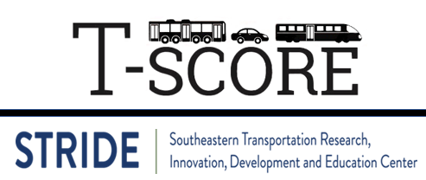
Lecture #2: Transit Modes
[Course Instructor]
[Course Semester]
[Course Number]
Materials developed by C. Brakewood, K. Watkins, and J. LaMondia.

Slide 2
Outline
Transit Modes
  Characteristics of different modes
  Family of transit modes
  Comparison of mode usage in the USA

Slide 3
Key modal Characteristics
These characteristics allow us to differentiate between modes

Slide 4
Transit Mode Definition
3 Basic Characteristics:
  Right-of-Way (ROW)
  System Technology
  Types of Service
Adapted from Vuchic (2005). Urban Transit. Chapter 12.
Notes:
It is helpful to look at transit based on three characteristics that really define the difference between transit vehicles and service.
These characteristics allow us to systematically differentiate between modes.
Based on a classification systems, by Vukan Vuchic, in the 2005 Urban Transit book. Chapter 12.
Right of way is the strongest characteristic.

Slide 5
Characteristic 1: Right-of-way (ROW)
ROW C
Mixed Traffic
ROW B
Physically Separated
ROW A
Fully controlled
Street Transit
Semi-Rapid Transit
Rapid Transit
Speed of Vehicles
Operating & Capital Costs
Vuchic (2005) page 554.
Walker (2012) Ch. 8. page 99.
Notes:
Right-of-way is the first way to characterize transit. Right-of-way is the strip of land where transportation vehicles operate. AKA transit way or running way.
ROW C is in with general traffic with no priority or separation. ROW C is neither exclusive nor separated (at intersections with other traffic).
ROW B is physically separated like a bus lane with barriers, but still interacts at intersections. Exclusive by not separated (usually cross other traffic at signals).
ROW A is fully controlled. ROW A is exclusive (no other traffic operates in the lane/track), and it is separated (traffic cannot cross).
As you move from ROW C to ROW A, the transit vehicles move faster, but at a higher cost to construct the system.

Slide 6
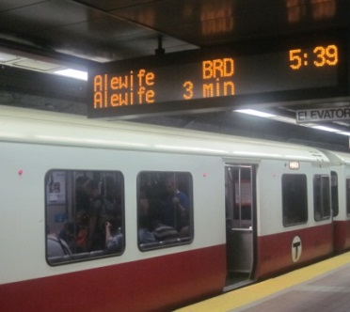
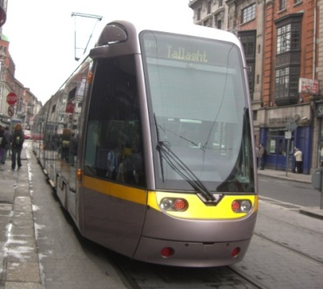
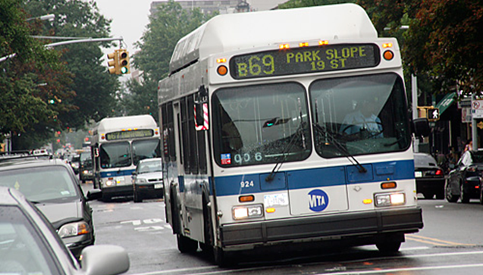
Examples of ROW Classes
Class A: Boston Red Line
Class B: Dublin Light Rail
Class C: MTA Bus
Notes:
Here’s an example of what this looks like in practice.
In the top picture (ROW A), you see the rail in its own space, pulled out of general traffic completely.
In the middle picture (ROW B), you see the rail in its own lane, but it is interacting at intersections.
In the bottom picture (ROW C), the bus is running in general traffic with no priority.
Bus and rail can be any of the three classes. Often, heavy rail is class A, and buses are Class C, but we see increasing use of bus in ROW B and even ROW A.
Very nicely explained by Jarrett Walker on page 99 in Chapter 8.

Slide 7
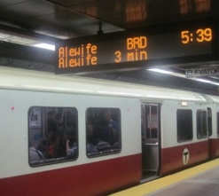
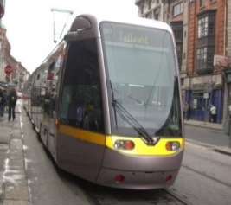
Pros and Cons of Rights of Way
Highest performance
Electric guided technology
High safety
Short dwell time
ROW A
Highest investment cost
Rigid alignment
Grade-separated stations require land and longer access
ROW B
Higher performance – speed, reliability, capacity,
comfort, safety
Use of longer vehicles
Stronger identity/ image
Lower per passenger operating cost
Can be electrified
ROW C
Require space for ROW
Higher investment
Special signals or control / priority measures
Notes:
A VERSUS B:
When a system moves from ROW B to ROW A, obstacles to operation are completely removed and the line moves into the highest level of performance.
The ability to use electrically propelled guided technologies creates very high dynamic performance.
Absence of interaction with other modes (and their non-professional drivers) results in the highest safety.
Long trains with multiple doors at platforms reduce the per passenger dwell time immensely.
Again, this comes at a cost, this time a significant cost.
In addition, the rigid alignment requires use of tunnels or aerial/ elevated in most situations, with greater social & environmental impacts (visual, property, disturbance in construction).
The rigid alignment also loses any flexibility as further development occurs in an urban area.
Finally, the grade-separation requires passengers to climb up or down which takes longer and requires greater space in stations.
B VERSUS C:
Advantages of moving from C to B:
When a system moves from ROW category C to ROW category B, several operating characteristics improve.
Without congestion in the lane, speed and reliability improve, because vehicles are less impeded. Capacity improves as well, because there is limited spatial competition. With less stop and go, the riding comfort and safety improves. Longer vehicles can be used in this ROW, with light rail chained in 2 to 4 units and buses such as double articulated. By giving a system more permanence, it has a stronger identity, which can lead to more economic development near stations and higher ridership. With the improved speed and reliability, the operating cost goes down per passenger. Finally, separate ROW can allow for electrification which provides higher vehicle performance and no local pollution.

Slide 8
Characteristic 2: System Technology
Support:
Vertical Contact
Rubber tire on pavement
Steel wheel on rail
Vehicle on water, mag lev, etc.
Guidance:
Lateral Control
Steered by driver
Guided by track
Control:
Spacing
Manual/visual
Manual/signals
Automatic
Propulsion: Power System
Diesel engine
Electric motor
Hybrid
Magnetic forces, etc.
Notes:
Support is the vertical contact between the vehicles and the riding surface. It can be rubber tire on concrete/ asphalt/ pavement or steel wheel on a steel rail. It can also be rubber on other surfaces, vehicles on water, air cushions, or magnetic levitation. Steel on rail generally has lower resistance than rubber, resulting in less energy consumption and better rider comfort. However, rubber can negotiate sharper curves and higher grades. The choice should be context sensitive.
LATERAL = SIDE TO SIDE : Guidance is the lateral control of the vehicle. A vehicle can be steered by a person inside (wheels provide lateral stability) or guided by the tracks. By guiding on tracks, larger vehicles can be used with less potential driver error. Driver-steered vehicles gives more flexibility to mix with traffic.
Propulsion is how a vehicle is powered. It can be diesel, electric, magnetic, and so on. Generally, electric power allows for higher acceleration and operating speeds; regenerative braking allows recovery of energy; there is less noise and vibration, and no local air pollution. However, a power failure stops all vehicles on the line and lines must be installed wherever service is to occur, giving less flexibility.
LONGITUNAL SPACING - Control is the means of regulating travel, including longitudinal spacing. It can be completely manual, such as a bus controlled by the driver. It can be manual with signals, such as trains. It can also be automatic, such as a people mover. The advantage of moving to a fully automated system is very frequent operation of short trains, optimization of driving regimes, and limited manpower. However, it requires ROW A, higher investment, more maintenance, and often the crew is needed for security or passenger information anyway.

Slide 9
Characteristic 3: Types of Service
Express
Rapid
Local
Notes:
Express buses run a longer distance making some stops, then traveling a longer distance before making several destination stops, often in a city.
A rapid, or skip-stop, service will run longer distances between stops to move faster, but with longer access times or less potential ridership.
A local service will make many stops along the entire route.
Each of these have varying reasons for being implemented, but the major one is if you are interested in travel time or access.
Also, characterized as trunk versus feeder.

Slide 10
Families of transit modes
This classification of usage leads us to our

Slide 11
Remember this chart…
Characteristic | Private |  | For-hire |  | Public
Designation | Private |  | Paratransit |  | Transit
Availability | Owner |  | Public |  | Public
Supplier | User |  | Carrier |  | Carrier
Route Determination | User (Flexible) |  | User | User (Carrier) | Carrier (Fixed)
Time-Schedule Determination | User (Flexible) |  | User | User (Carrier) | Carrier (Fixed)
Cost-Price | User absorbs |  | Fixed RATE |  | Fixed FARE
Carrier Type | Individual | Group | Individual | Group | Group
Modes | SOV | Carpool | Taxi/ Uber | Dial-A-Ride | Street Transit
 | Motorcycle | Vanpool | Rent Car/ Car Share | Jitney | Semi-Rapid Transit
 | Bicycle |  | Bike Share |  | Rapid Transit
 | Walking |  | Scooter Share |  | Specialized
Adapted from Vuchic, 2007
Notes:
We break this down into “street transit”, “semi-rapid transit”, and “rapid transit” as well as some specialized modes we’ll come back to.

Slide 12
Family #1: Street Transit Modes
Regular Bus
Express Bus
Trolleybus
Streetcars (trams)
Notes:
Regarding transit modes, let’s divide them into our ROW categories A, B and C.
Street transit is ROW category C. Remember it runs in the street with other vehicles without any (or much) priority.

Slide 13
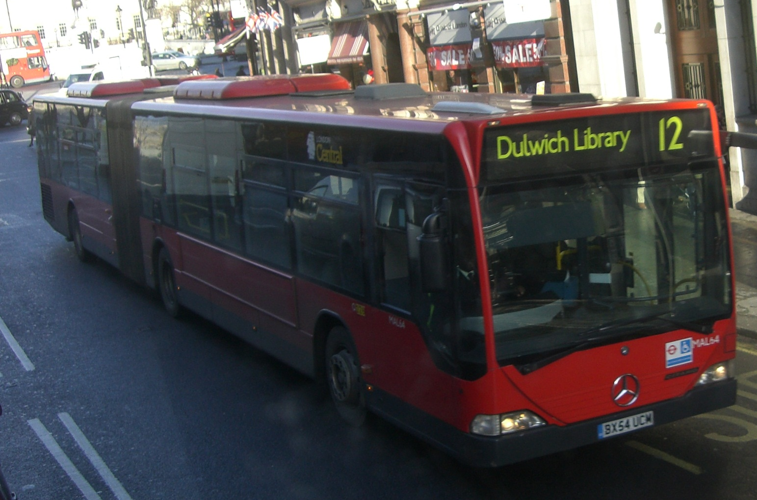
Regular Bus
Articulated Bus in London (Bendy Bus)
Image source: Candance Brakewood
Notes:
Most agencies uses standard size buses. (Capacity ~ 40-seater)
However, many larger cities use articulated buses, which in London, they call a Bendy Bus.
Why would you do this?
Answer: Drivers are expensive – serves many more people for just one driver.

Slide 14
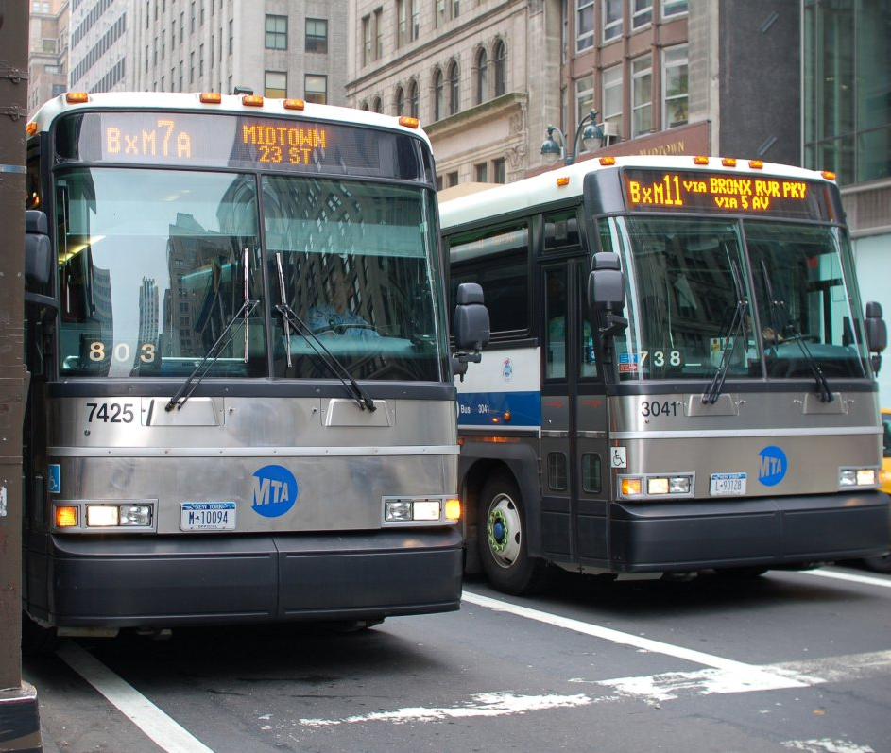
Express Bus
MTA X Routes
Image source: http://www.railfanwindow.com/blog/tag/express-bus/
Notes:
Express buses are similar to standard bus, although a bit more comfortable. The difference here is in service – travels long distance without stopping. It works well in places where people commute into a city from another smaller city or suburb.

Slide 15
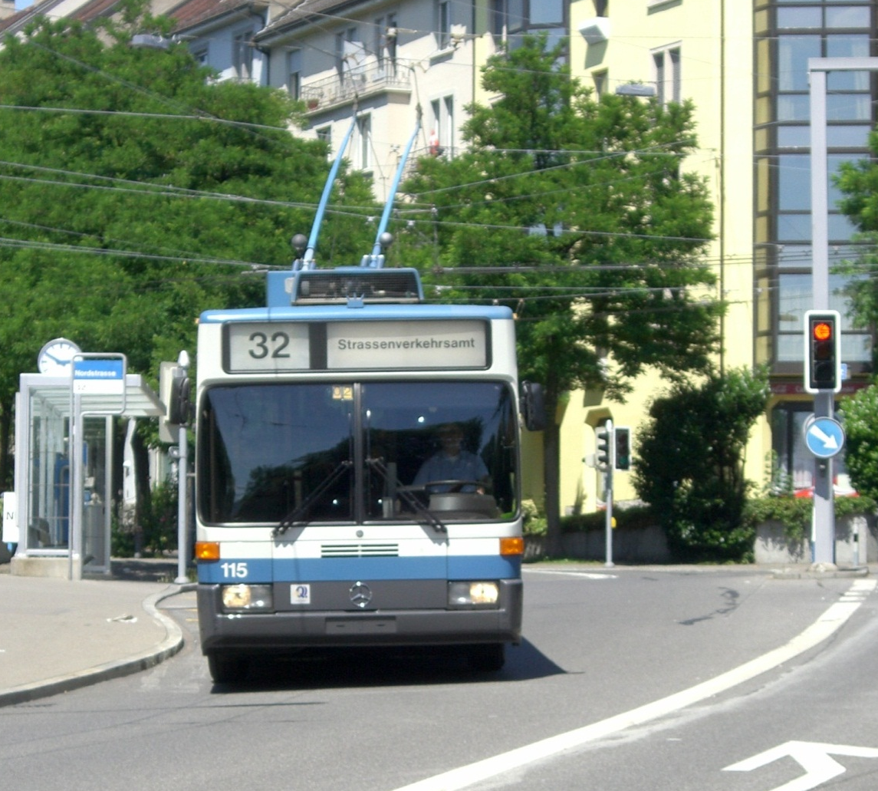
Trolleybus
Trolleybus in Zurich, Switzerland
Image source: Candace Brakewood
Notes:
This is similar to a standard articulated bus. The difference here is in propulsion technology. It is powered by overhead electrical lines. Trolleybuses are predominantly used by MUNI in San Francisco and King County Metro in Seattle. SEPTA in Philly, MBTA in Boston, and DRAT in Dayton also operate a few lines.

Slide 16
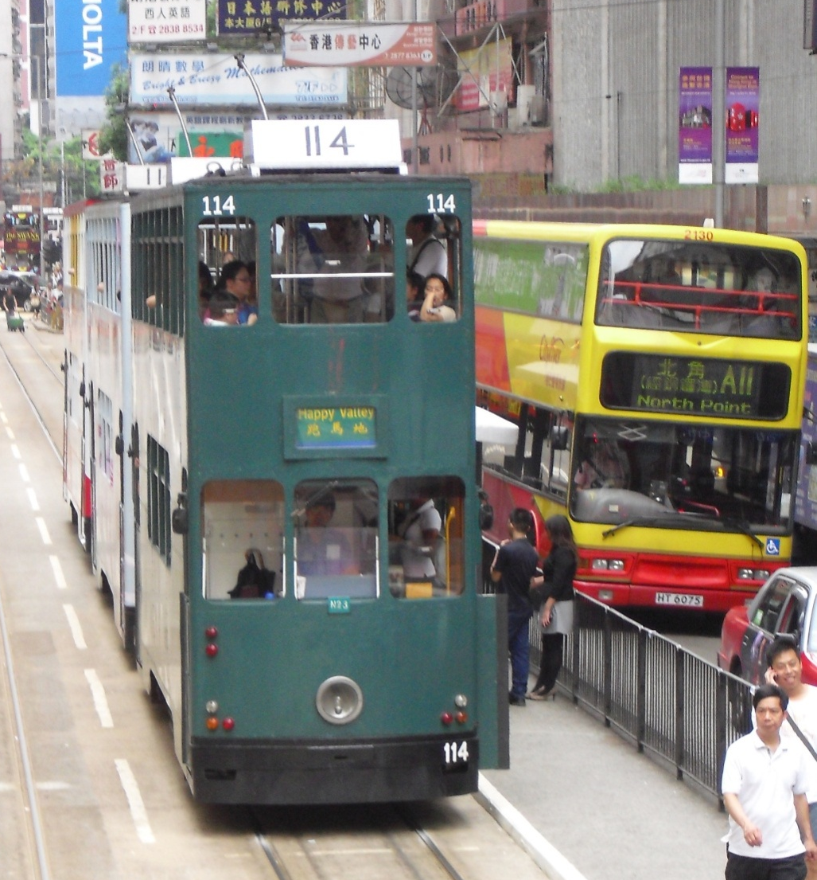
Streetcars
Double Decker Streetcars in Hong Kong
Image source: Candace Brakewood
Notes:
With streetcar (tram) the ROW is still category C. The difference here is in support – this runs on tracks (steel on steel) instead.
This streetcar is in Hong Kong, which is double decker. The tramways were one of the earliest form of public transport in Hong Kong.

Slide 17
Family #2: Semi-Rapid Transit Modes
Bus Rapid Transit
Light Rail Transit
Automated Guideway Transit
Notes:
Now moving into ROW category B. Semi-rapid transit has some priority over other vehicles. It usually has its own lane, but still interacts at intersections.

Slide 18
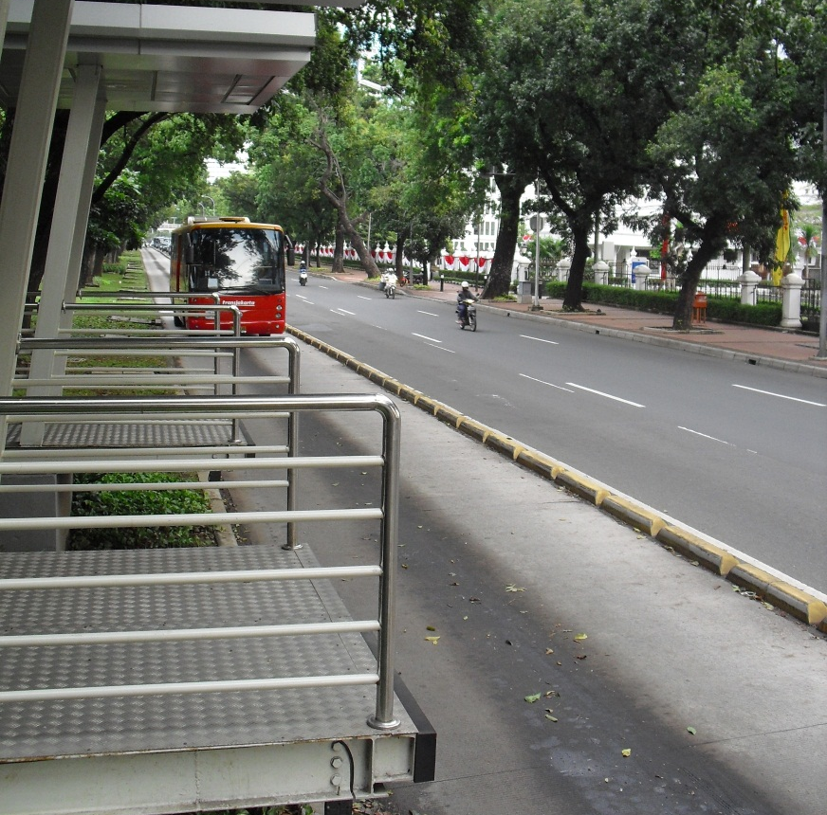
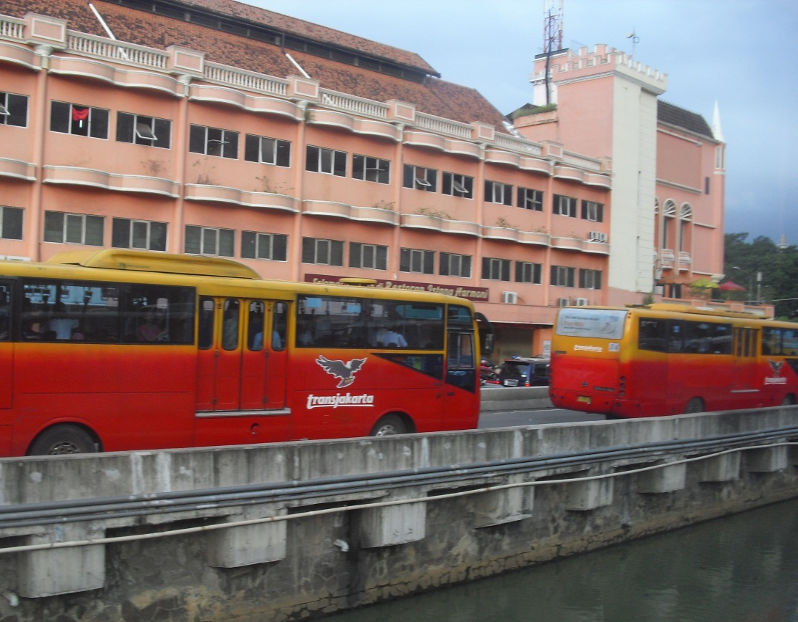
Bus Rapid Transit
TransJakarta, Jakarta, Indonesia
Image source: Candace Brakewood
Notes:
Bus Rapid Transit (BRT) often gives priority over other vehicles by putting buses that could travel in the streets in their own lane. Bus Rapid Transit can rely on adjusted signal timing to give buses priority. It also has queue jumps, and lanes that allow buses to bypass traffic and pull ahead at traffic signals. We will talk more about this in coming lectures.
This picture is of TransJakarta, which is a BRT system that began operations in 2004. Buses have a dedicated lane with a curb separating from traffic. There is off board fare collection to speed boarding.
In places like Bogata, Columbia, the BRT borders on ROW A with fully controlled stations and very frequent service.

Slide 19
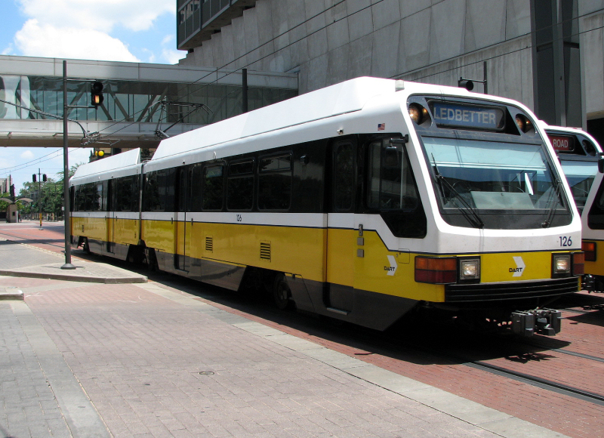
Light Rail Transit
Dallas Area Regional Transit
Image source: http://www.dallassouthnews.org/
Notes:
Light rail transit (LRT) also runs in its own lane typically but is on tracks rather than pavement.
Light rail is very similar to streetcars (trams). According to Vuchic (page 69-70), LRT is essentially an upgraded streetcar with modern technologies. Usually ROW A or B, instead of B or C. Usually regulated crossings at intersections (such as signal priority), usually 2-4 car vehicles (instead of 1-3 for trams).

Slide 20
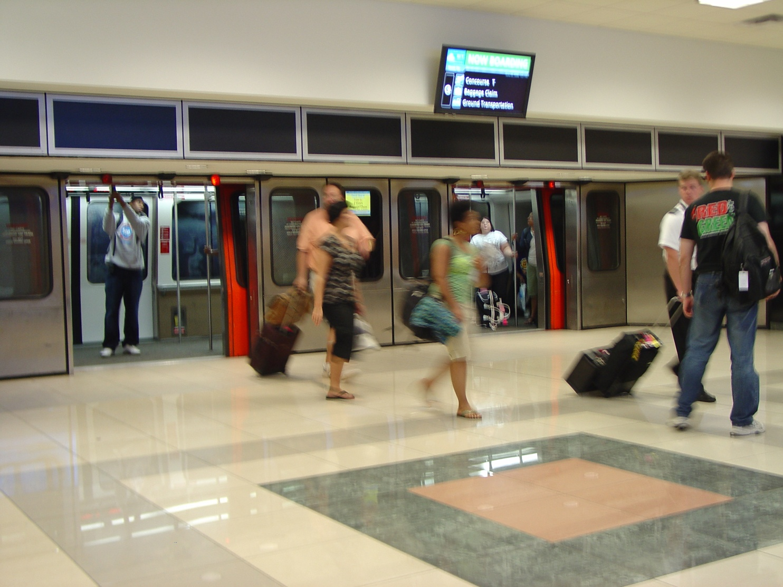
Automated Guideway Transit
Hartsfield-Jackson Atlanta Airport
Image source: commons.wikimedia.org/wiki/File:ATL_People_Mover_2.jpg
Notes:
Automated Guideway has its own space completely, not interacting with other vehicles. However, the vehicles are small, so it is run more frequently with closer stops, thus making it semi-rapid rather than rapid transit. Often used in airports, but also as “people movers” in Miami, Detroit and Jacksonville.
Q: Why is it often used in airports but not elsewhere?
A: Remember back to what we talked about with fully-controlled. It is expensive and the cost savings from less manpower is usually overridden by the need to have someone on the vehicle for security and to assist riders anyway. In airports, the security was already addressed before passengers boarded.

Slide 21
Family #3: Rapid Transit Modes
Rail Rapid Transit (Metro, Subway or Elevated)
Light Rail Rapid Transit
Rubber-tired Rapid Transit
Monorail
Regional (Commuter) Rail
Notes:
Now for ROW category A. Rapid transit vehicles run completely in their own ROW, not interacting with other vehicles except units ahead or behind on their own tracks.

Slide 22
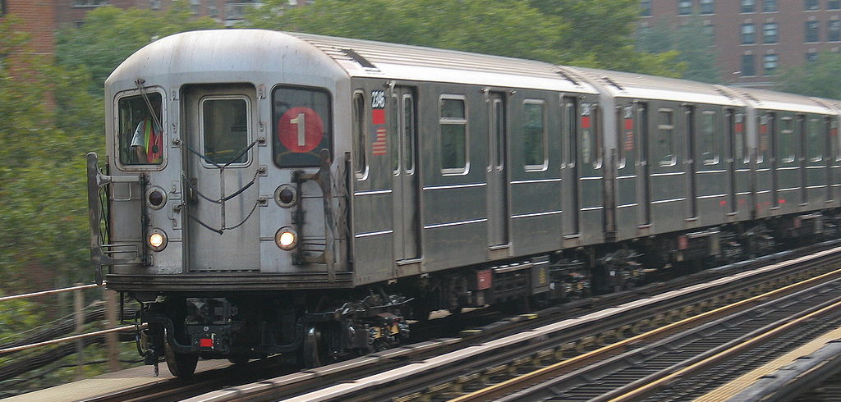
Rail Rapid Transit (Subway, Metro, Elevated)
No. 1 Train, New York City
Image source: Candace Brakewood
Notes:
Typically, large 4 axel vehicles. ROW A. High speed, high reliability and capacity.
Subway trains.

Slide 23
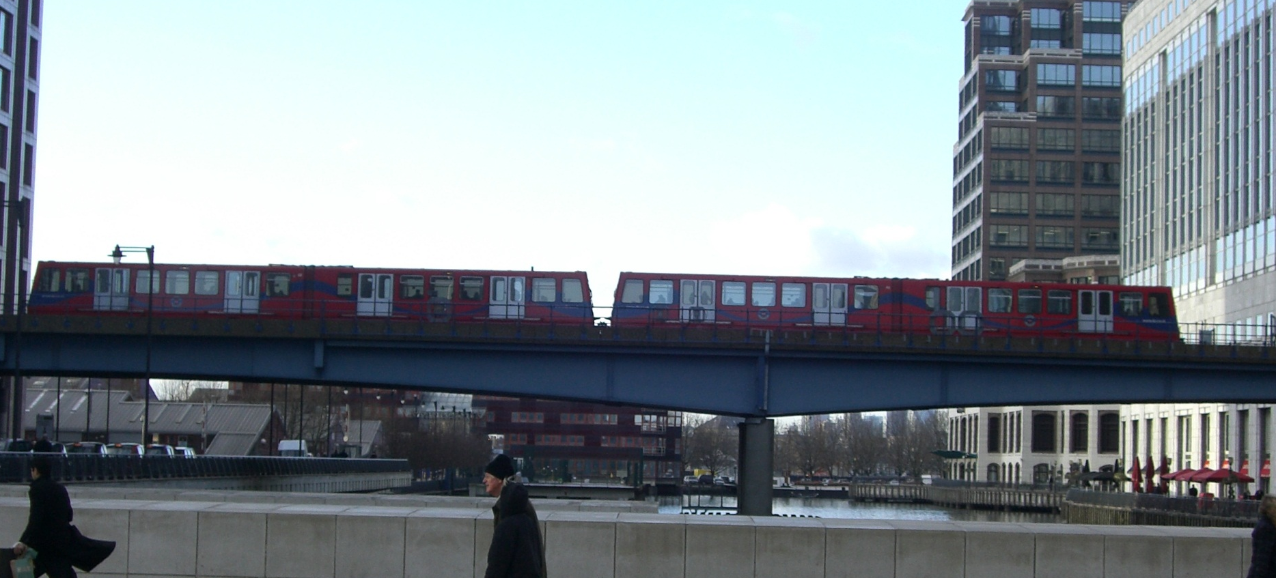
Light Rail Rapid Transit
Docklands Light Railway (DLR) in London
Notes:
The same light rail vehicles you saw previously can have exclusive right-of-way. The difference here from a subway system is the narrower vehicle (also can have fewer cars).
Usually used when don’t have high enough passenger volumes to justify heavy rail.
Some operate without drivers (full automation). This is the case of the Dockland light rail in London.

Slide 24
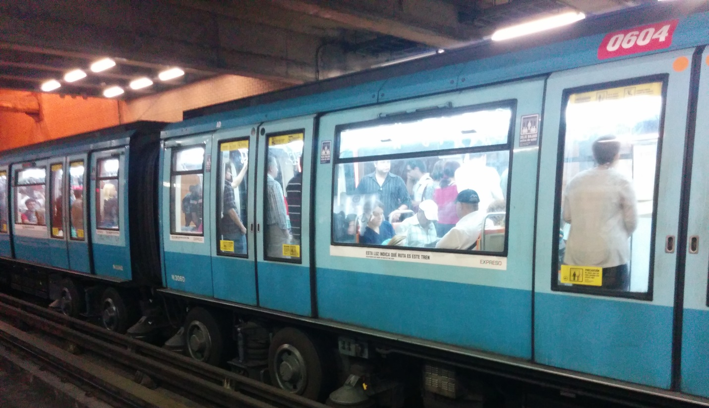
Rubber-Rired Metro
Santiago, Chile
Image source: http://www.vassg.hu
Notes:
ROW A
Other vehicles are similar to our subway systems, but they use a French technology that has rubber tires, but still runs on tracks.
This technology is used in Paris, Lyon and Marseille, but also places where the systems were designed and built by the French, such as Montreal, Santiago (Chile), and Mexico.

Slide 25
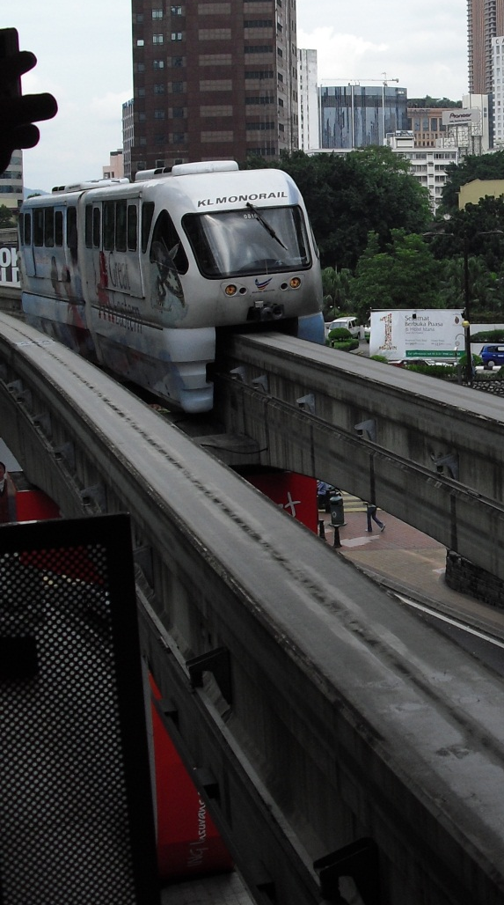
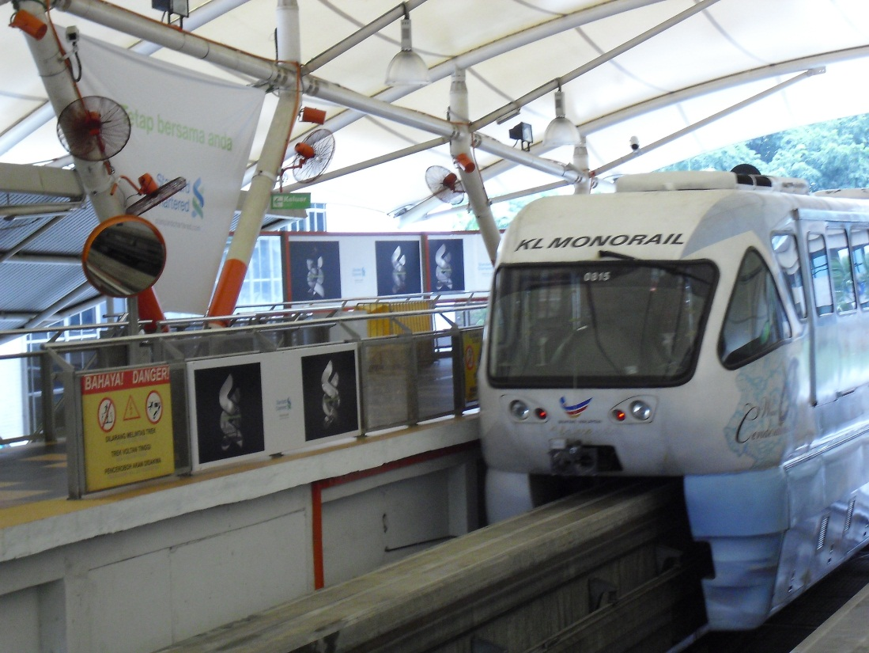
Monorail
Kuala Lumpur, Malaysia
Image source: Candace Brakewood
Notes:
Some systems ride on or are suspended from a single rail, so we call them “mono-rails”. Seen as high tech at one point in time, but it tends to be more visually obtrusive.
The only public (FTA-regulated) operating system in the US is a one-mile line in Seattle. The monorail in Las Vegas is privately owned and operated. There is also a monorail in Walt Disney world in Florida. Others in the US are only found at tourist attractions; however, monorails are often found abroad, especially in Japan.

Slide 26
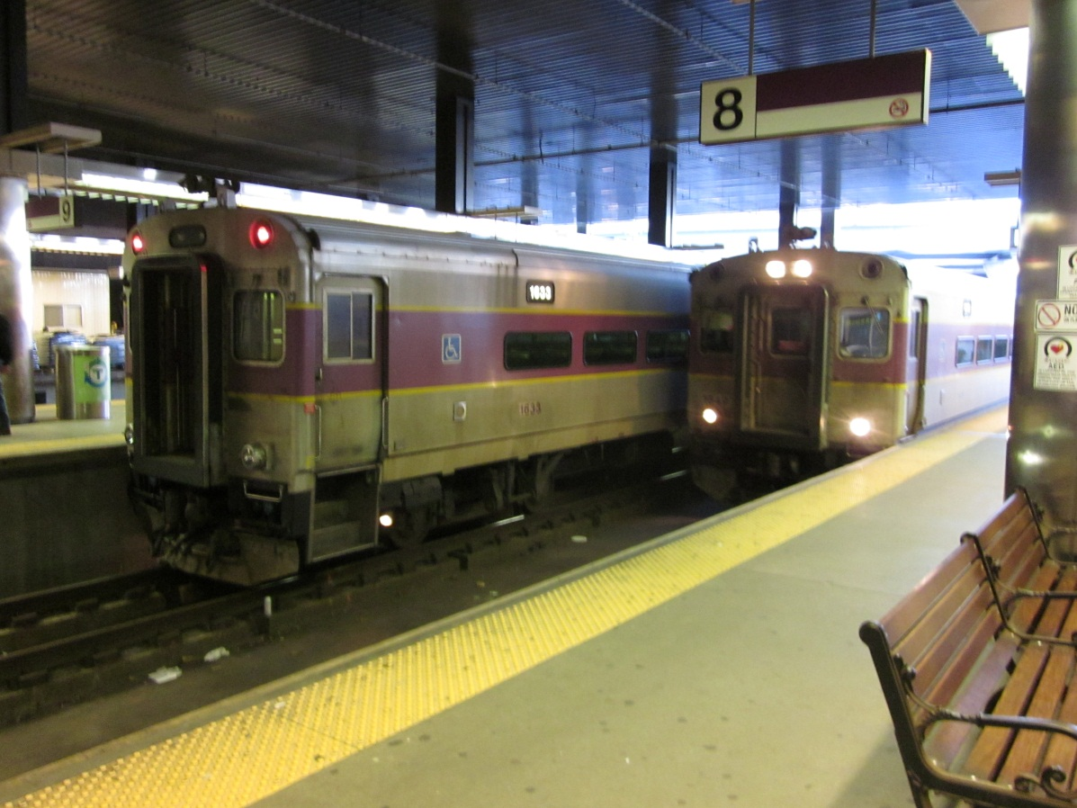
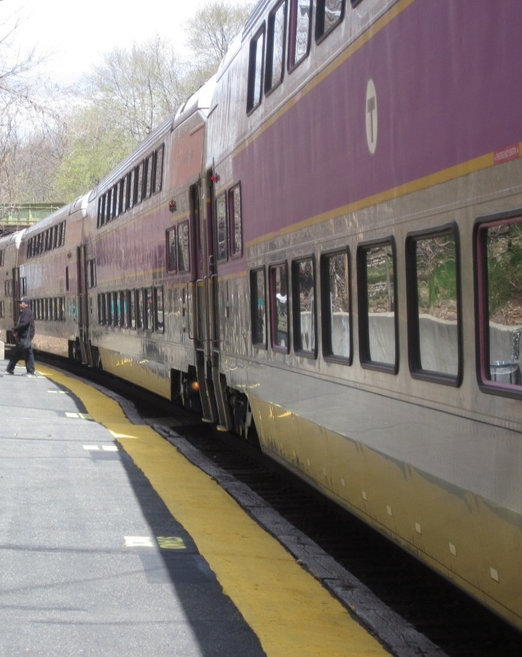
Commuter Rail
Boston, Massachusetts
Image Source: Candace Brakewood
Notes:
Finally, much larger vehicles in trains on longer routes with fewer stops and at higher speeds are regional or commuter rail.
Boston’s commuter rail system has many double-decker trains to increase capacity.

Slide 27
Family #4: Specialized Modes
Terrain-Specialized
  Cable cars
  Funicular / inclined plane
  Aerial tram
Water-based
  Ferry
Notes:
Finally, some modes are specialized for the locations in which they run.

Slide 28
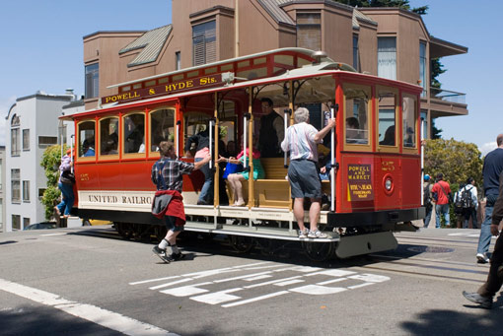
Cable Car
San Francisco, CA
Image source: SFMTA
Notes:
Cable cars are powered by physically attaching the vehicle to a continuously moving cable in an underground slot. Cable cars in San Francisco have remained due to the hilly terrain (and the tourist appeal). Traditional rail is typically only up to 10% grade and buses up to 15% grade.

Slide 29
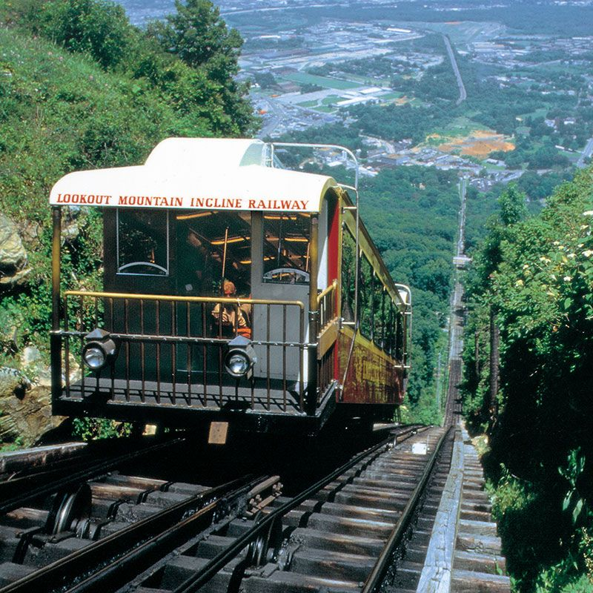
Funicular / Incline
Incline Railway, Chattanooga, TN
Image source: http://www.ridetheincline.com/
Notes:
Funiculars are also used on steep gradients. Two vehicles tied on two ends of a cable are pulled as a balanced pair by a motor powering the cable.
Pittsburgh is famous for their inclines. They are also used in Chattanooga, TN and Johnstown, PA, and Pittsburgh PA. Funiculars are more often seen abroad in places like Hong Kong, Salzburg and many South American cities.
Chattanooga: breathtaking 72.7% grade

Slide 30
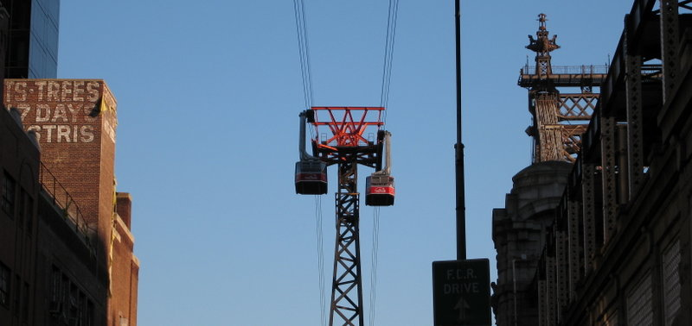
Aerial Tram
Roosevelt Island, NY
Image source: en.wikipedia.org/wiki/File:Roosevelt_Island_Tramway.jpg
Notes:
Aerial trams are systems of cable-suspended and cable-powered pairs of balanced cars used to move people over water or between two hills.
In the US, this is used only in Portland, Oregon and Roosevelt Island, New York. They are often found abroad in such places as Rio de Janeiro and Cape Town.

Slide 31
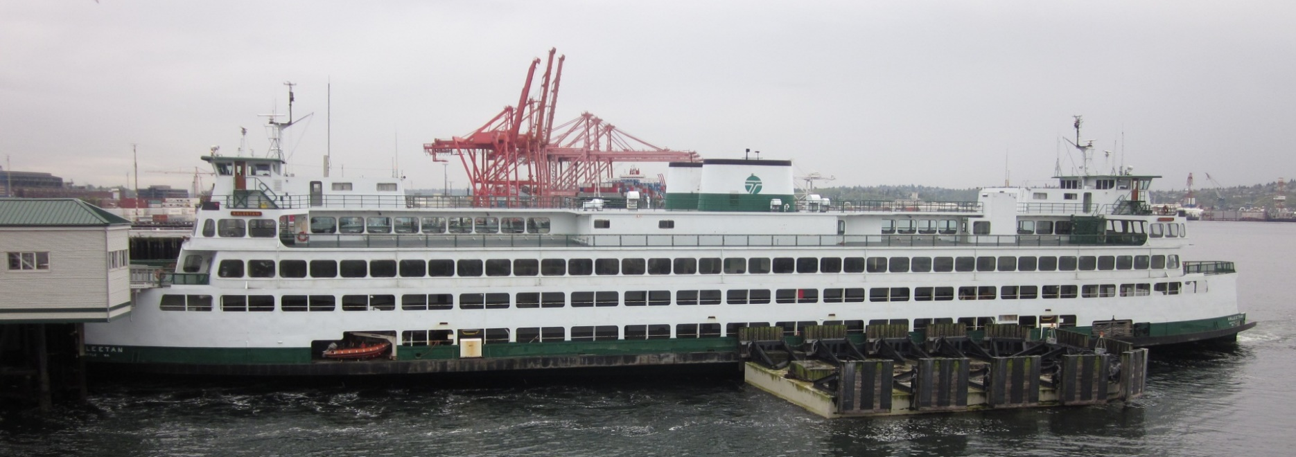
Ferries
Seattle, Washington
Seattle, WA
Image source: Candace Brakewood
Notes:
Ferris people (and cars) across large bodies of water.
Washington State Ferries (Seattle) is the largest ferry service in US. New York City has several companies that operate ferries. Other systems include San Juan, New Orleans, Boston, and Portland.

Slide 32
Comparison of Modes in the USA
Notes:
What is the current status of these modes in the USA?

Slide 33

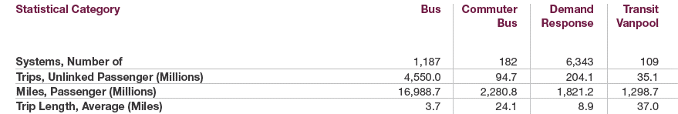
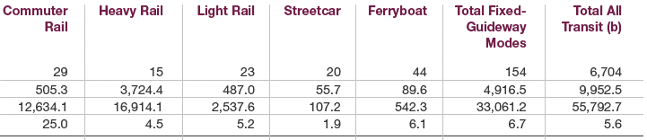
APTA: Nationwide Pax Trips by Mode
Source: 2020 APTA Fact Book, pages 4-5
Notes:
This is over 2 pages in the 2020 version of the APTA factbook.
Nationwide comparison by mode.
Number of system → most are bus; only a few heavy rail system
Nearly 50% of unlinked pax trips nationwide are on bus.
About 35% on heavy rail.
When we look at pax miles, heavy rail and bus almost identical (implies longer trips made on heavy rail).
Across the country, most of transit is bus service.
This is from the 2020 APTA factbook; most of the data was collected in 2018.

Slide 34
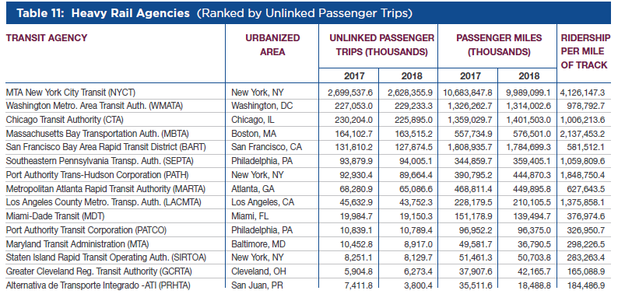
APTA: Largest Heavy Rail Agencies
Source: 2020 APTA Fact Book, page 45
Notes:
Heavy rail service is provided by electric rail cars on private rights-of-way. The trains are boarded in stations from high level platforms. Heavy rail provides high-speed service with the ability to carry "heavy“ loads of passengers. Heavy rail service is separated from vehicle and pedestrian traffic, often elevated or in subways, or in private at-grade rights-of-way.
Now let’s look at NYC specifically…. NYCT has about 2.6 billion unlinked heavy rail trips per year.

Slide 35
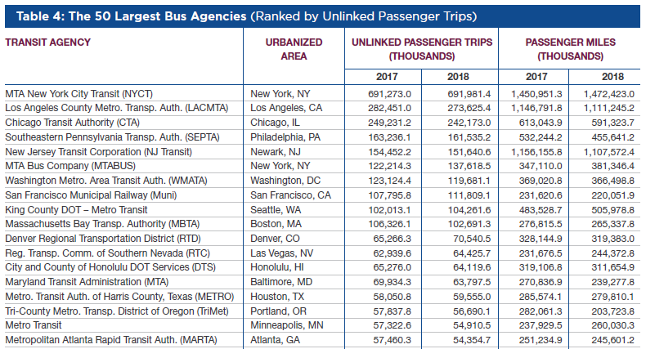
APTA: Largest Bus Agencies
Source: 2020 APTA Fact Book, page 35
Notes:
Note: this does not include BRT and commuter bus. They are in a separate table
NYCT operates about 690 million unlinked passenger trips on the bus system each year
More on the subway than the bus.

Slide 36
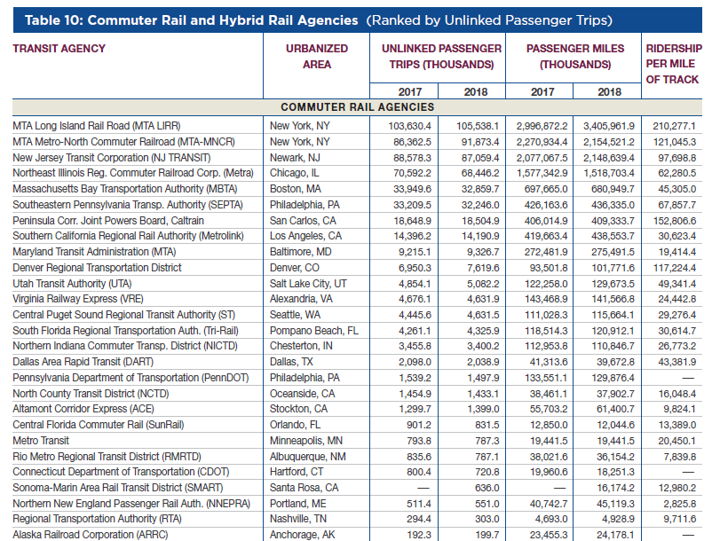
APTA: Largest Commuter Rail Agencies
Source: 2020 APTA Fact Book, page 39
Note: Hybrid Rail agencies not shown here
Notes:
Old commuter rail systems. Three of which are in the tristate area (New York, New Jersey, and Connecticut).
Mainly the old system.

Slide 37
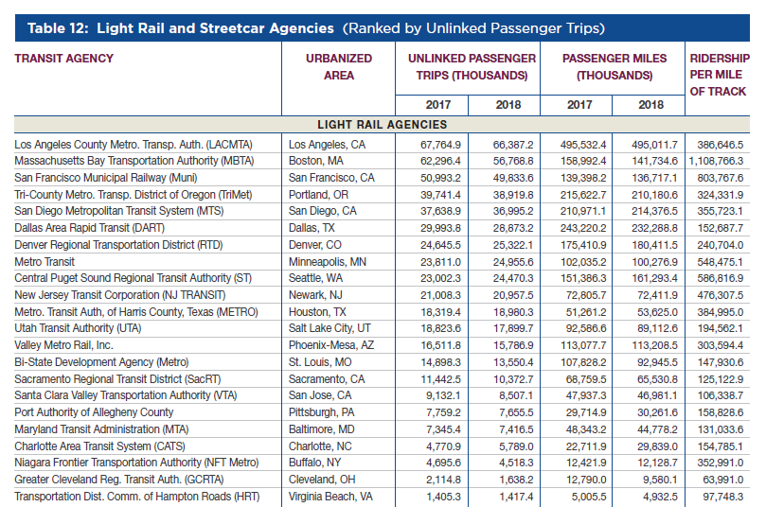
APTA: Largest Light Rail Agencies
Source: 2020 APTA Fact Book, page 41
Note: Streetcar agencies not shown here
Notes:
Different cities
been a resurgence in light rail.
Portland, LA, San Diego, DART → new light rail

Slide 38
New Diversity of Transit Modes
More rail being constructed; since 1970:
  At least 7 new heavy rail systems constructed (BART, WMATA, MARTA, Baltimore, Miami, LA, San Juan)
  Approx. 20 cities opened or are constructing new LRT systems
Resurgence in streetcars and tramways after decades of elimination, such as
  Atlanta and Washington DC recently opened streetcars
Buses traditionally non-priority
  Buses carry a large share of transit passenger trips
  Mostly transit captive
  BRT is changing this
Notes:
1970s & later new metro systems: Baltimore (1983), Miami (1984), Los Angeles (1993), San Juan (2005)

Slide 39
Concluding Remarks
Understanding the differences in transit modes is critical
Cities often require multiple modes integrated and working together for high ridership
Make the mode fit the service instead of the service fit the mode – rest of course focuses on service
Notes:
As a transit planner or a consultant working with public transportation agencies, it is important to take a systems approach. Each mode of transit has different advantages and disadvantages.
Systems Approach: Cities require multiple modes integrated and working together for the highest ridership.
Looking at the whole transportation system and impacts of the transportation system on other systems is critical in transit mode choice.
Transit mode choice will depend on many factors.

Slide 40
Reference
Materials in this lecture were taken from:
Vukan Vuchic, “Urban Transit Operations, Planning and Economics” (2005).
APTA (2020) Public Transportation Fact Book.
Jarrett Walker Ch 8

