Slide 1
Lecture #19: Transit Information
[Course Instructor]
[Course Semester]
[Course Number]
Materials developed by C. Brakewood, K. Watkins, and J. LaMondia.

Slide 2
Outline
Means of communicating with transit travelers
Advances in transit information provision
Online trip planning (Google Transit & GTFS)
Real-time information
Service alerts

Slide 3
TCQSM – Information Availability
Passengers need to know
How to use transit service?
Where to go to access it?
How to pay fare and how much?
Where to get off near their destination?
Any transfers required?
When are services scheduled to depart and arrive?
When are there adjustments/disruptions to service?
TCQSM Page 4-30
Notes:
Means of communicating by travelers – TCQSM Chapter 4 – what do people who are using your system need to know?

Slide 4
TCQSM – Means of Providing Information
Printed - timetables, maps, service change notices
Posted - system maps or notices posted at stations, on vehicles, etc.
Transit infrastructure – signage directly drivers to park-and-ride lots, bus stop signs indicating stop, etc.
Audible announcements - stops, train directions, etc.
Visual displays - on-board or in stations (e.g., LED signs)
Transit agency staff - station agents or tourist info staff
Telephone information - call center, automated menus, SMS
Online information - trip planning, real-time, fare info
Smartphone apps - trip planning, real-time, fare info
TCQSM Page 4-30
Notes:
Audible announcements - stops, train directions → help those with visual impairments. Also, unfamiliar passengers (e.g., tourists, or someone who has not ridden before)
Visual displays – on-board or in stations → supplement onboard announcements

Slide 5
Online Trip Planning & GTFS
Data standards & open data have changed how riders access information.
Notes:
So, we’ve spoken about many rider tools that have been developed, but are these the tools that riders need to overcome the barriers to transit use? In order to find out, we started a process from the computer-science world called Value Sensitive Design (VSD).
VSD is a principled approach for examining the set of values implicated in an information technology system. The “values” in VSD refer to “what a person or group of people consider important in life” – things like freedom, community, or clean air. In order to investigate the impact on people’s values, VSD integrates three types of investigations - conceptual, empirical and technical – in an iterative process.

Slide 6
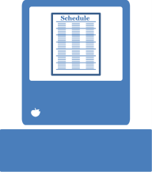
History of Schedules
Paper Schedules Digitization Interactivity
Schedule
10
9:36
Image Source: Landon Reed
Notes:
Initially paper schedules. They want to be comprehensive and concise, but they can be difficult to read and flood rider with information – best we can do at this point.
Migration of paper schedules to an electronic format, but they had substantial changes. It was just provided on the agency’s website as either a pdf or integrated into a web page.
Moving further, developers and agencies started to see new ways to deliver this information through interactive applications that give riders only the information that they’re interested in.

Slide 7
Google Transit
Transit on Google Maps is a public transportation planning tool that combines the latest agency data with Google Maps. It integrates transit stop, route, schedule, and fare information to make trip planning easy.
https://www.google.com/maps/
Notes:
Source: Google Transit

Slide 8
General Transit Feed Specification (GTFS)
The General Transit Feed Specification (GTFS) defines a common format for public transportation schedules and associated geographic information. GTFS "feeds" allow public transit agencies to publish their transit data and developers to write applications that consume that data in an interoperable way.
routes.txt
agency.txt
trips.txt
shapes.txt
stops.txt
stop_times.txt
calendar.txt
GTFS
Image Source: Landon Reed
Notes:
A GTFS feed is composed of a series of text files collected in a ZIP file. Each file models a particular aspect of transit information: stops, routes, trips, and other schedule data. The details of each file are defined in the GTFS reference.
Shapes: Rules for drawing lines on a map to represent a transit organization's routes.
GTFS is a used as a standard in representing schedule and route information in the United States. GTFS takes various schedule information like route and stop name and zips it into a file.

Slide 9
GTFS Example
Source: https://developers.google.com/transit/gtfs/examples/gtfs-feed
Notes:
This is an example of GTFS.
The first text file shows information about the agency. This example is called FunBus.
The second text file shows stop information, including stop ids, stop names, etc.
The third text file shows every route in the system - Route ID (code), route short name (as the passenger would know it), then route title (more descriptive).
The fourth text file show information on the trip file (How schedule is set up).
The fifth text file shows the stop time file. It is a large file that shows the time that the vehicle is going by each stop (arrival and departure times).
The sixth text file shows the calendar information (service ID and operating days).

Slide 10
GTFS Continued …
Notes:
On the previous slide, you saw separate files for each piece of data in a GTFS feed.
This shows how to relate the different files. Common column names/ variables.

Slide 11
How does Open Data help?
Transit Agency
Agency produces data and opens it once.
DATA
Agency responds to special requests by developers
DATA
Anyone can access data
App Developers
Riders
Small subset of riders find this specific tool useful.
Many riders access a diverse market of tools powered by GTFS.
Image Source: Landon Reed
Notes:
In the traditional model, an agency responds to many different developers’ custom requests for information. It only allows for a small set of developers reaching a small subset of riders.
With the open data model, an agency proactively puts data out and anyone interested in the data can use it as they see fit. Open data model allows for more developers to participate for a larger and more diversified market for applications.

Slide 12
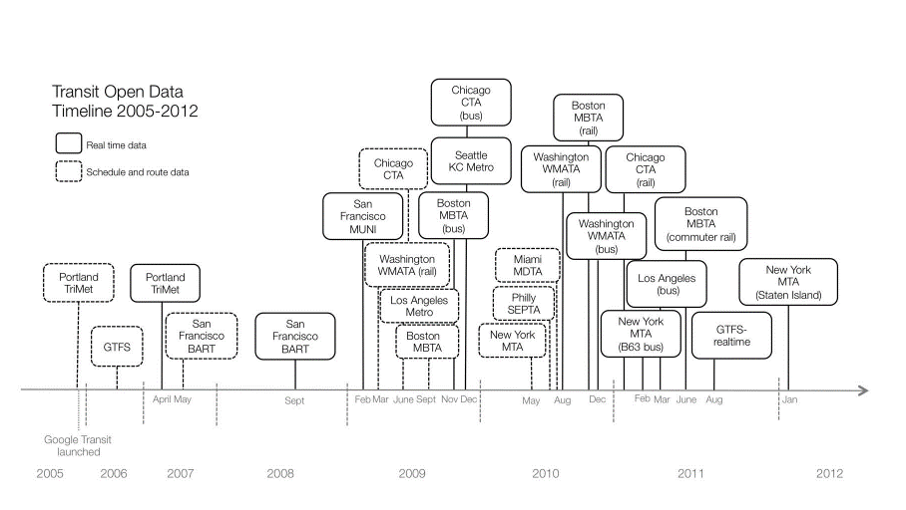
Open Data Trends (2005-2012)
Source: Rojas (2012)
Notes:
At the end of 2005, Portland, Oregon’s TriMet became the first transit agency to integrate its schedules and routes with Google Maps.
Timetable of transit data releases for largest transit systems in the United States from 2005 to 2012. Dashed-line boxes indicate static route and schedule information. Solid-line boxes indicate real-time data feeds of vehicle locations and arrivals. Source: author's research.
Both large and small agencies alike can successfully implement open data using GTFS.

Slide 13
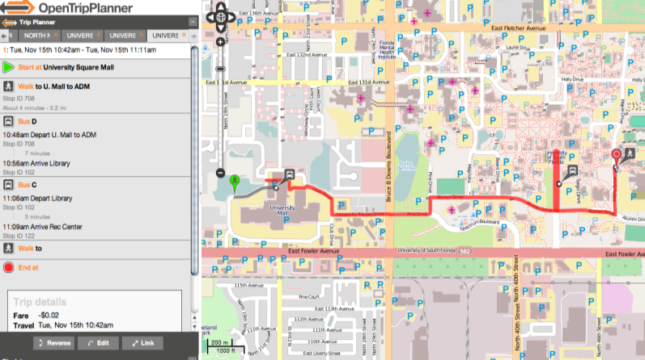
Using Open Data Example 1: OpenTripPlanner
http://www.opentripplanner.com
Notes:
OpenTripPlanner (OTP) is an open-source platform for multi-modal and multi-agency journey planning.
Multiagency tools, such as OTP, reduce the perception of a disconnected regional system. It encourages multimodal travel and provides users the necessary information to make informed trips. OTP can add cities with a GTFS feed in a short period of time and no cost to the agency.

Slide 14
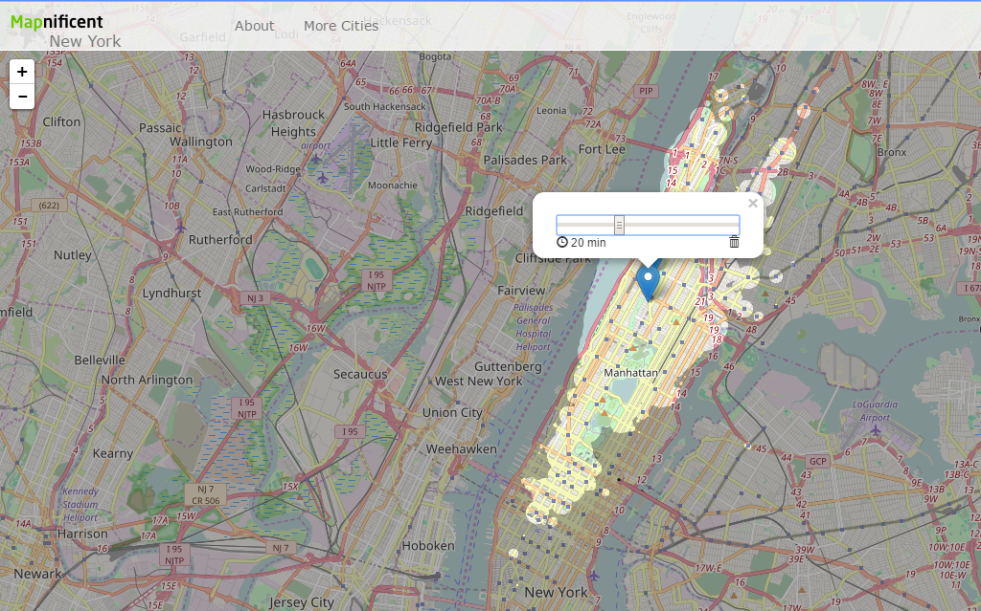
Using Open Data Example 2: Mapnificent
Shows you areas you can reach with public transport in a given time.
http://www.mapnificent.net/
Notes:
This is a visualization tool that shows you accessibility levels (shows you areas you can reach with public transport in a given time).

Slide 15
Using Open Data Example 3: Walk Score (Apartment Search)
https://www.walkscore.com/
Notes:
We talk a lot about apps, and for many people GTFS is really the key to getting on Google Transit. But what else is out there?
A new way to think about housing: based off your commute, how long will it take.
Find apartments for rent and rentals on Walk Score. Find apartments with a better commute, great nearby places, and transportation choices.

Slide 16
Real-time INFORMATION
How does real time information change user perceptions and behavior?
Notes:
With the opening of schedule data, real-time data from GPS devices etc. is becoming more commonly opened and available to passengers.

Slide 17
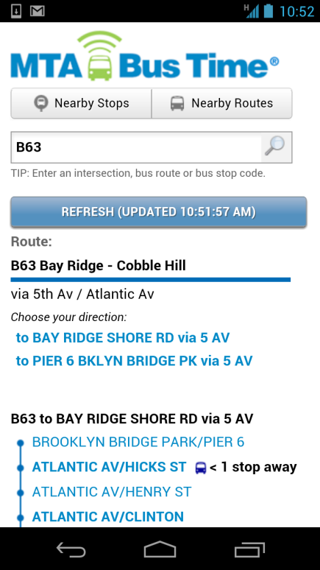
Why is real-time info important?
Public transit can be unreliable.
Improving reliability can be expensive.
Providing real-time transit information to riders via personal devices can help.
Image: Bus Time Mobile Website
Notes:
We can provide schedule information, but if the vehicle does not show up at that time, then passengers become very frustrated.
Traditional methods of improving reliability are expensive, supply-side approaches, including:
Increase right-of-way (e.g., mixed traffic → dedicated)
Service planning (e.g., add slack to running times)
Control strategies (e.g., holding vehicles)
Bottom line: want to improve the perception of reliability

Slide 18
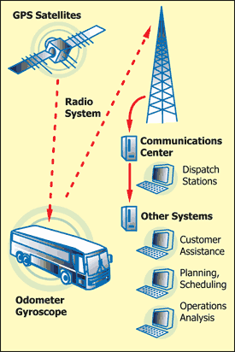
Enablers of real-time information
Increased use of AVL technology
Prevalence of mobile devices
Open, standardized data
Notes:
In the last 20 years, gps has become common. Wide adoption of gps technology
Image source: UNKNOWN ????

Slide 19
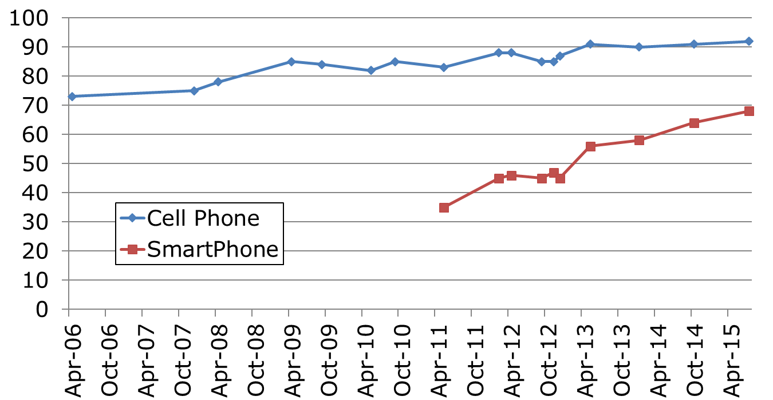
Enablers of real-time information
Increased use of AVL technology
Prevalence of mobile devices
Open, standardized data
Notes:
Passengers have their own technology so you have an easier way to provide constantly changing information.
How do then get we get information where the vehicle is to the passengers?
Data source: Pew Research Center ??? Need to double check

Slide 20
Enablers of real-time information
Increased use of AVL technology
Prevalence of mobile devices
Open, standardized data
Source: Rojas (2012)
Notes:
Push data and information quickly to the passengers.

Slide 21
Potential Benefits of Real-Time Info Apps
There are many potential benefits of providing real-time transit information apps to passengers.
Decreased Wait Times
could lead to
Increased Satisfaction
could lead to
Increased Ridership
Bus Stop
10
9:36
Notes:
There are three key benefits of passengers having real time vehicle location information.
Decreased Waiting Time. Passengers can time arrival time to bus stop to minimize wait time.
Increased Satisfaction. Reduction in perception of passenger wait time. If people spend less time waiting, leads to increased system satisfaction.
Increased Ridership. If passengers are happy with service, then people take more trips.

Slide 22
Benefits of Real-Time Information Apps
Numerous studies provide evidence supporting these passenger benefits.
Decreased Wait Times
could lead to
Increased Satisfaction
could lead to
Increased Ridership
Ferris, Watkins & Borning (2010)
Watkins, et al. (2011)
Brakewood, Barbeau & Watkins (2014)
Brakewood, Rojas, et al. (2015)
Others …
Ferris, Watkins & Borning (2010)
Gooze, Watkins & Borning (2013)
Brakewood, Barbeau & Watkins (2014)
Others …
Tang & Thakuriah (2011)
Tang & Thakuriah (2012)
Brakewood, Macfarlane & Watkins (2015)
Others …
Notes:
Sources that demonstrated the benefits of providing real time information through smartphone apps to passengers.

Slide 23
Summary of Real-Time Info Benefits
There are (at least) 28 studies evaluating the benefits of real-time information.
Sidewalk labs: https://medium.com/sidewalk-talk/the-real-benefits-of-real-time-transit-data-1fee19988b73
Talking Headways podcast: https://usa.streetsblog.org/2019/06/20/talking-headways-podcast-the-potential-of-real-time-information/
Brakewood and Watkins (2018). A literature review of the passenger benefits of real-time transit information. Transport Reviews.
Notes:
There are at least 28 studies just evaluating the passenger impacts of real-time information.
Note: these studies are about real-time information, both through apps and through signage (e.g., variable message signs).
What about other types of information? Particularly those that affect transit ridership?

Slide 24
Service alerts
Telling riders if something goes wrong with service
Notes:
Real-time information is good when the vehicle is running on schedule or close to it.
But what about when there are major delays?
Service alerts, known as “T-alerts” in Boston, include emails and text messages
that report major delays (more than 15 minutes) to subscribers. Riders can sign up for
mode- and line-specific alerts, which are automatically pushed to their cell phone or
email account in the event of a delay.

Slide 25
Service Alerts: Today
Text message
Email
Websites
Social Media
https://twitter.com/NYCTBus?lang=en
Notes:
Websites and social media – often you have to pull this information.
Text message and email – this is often pushed. You can sign up for specific alerts.

Slide 26
Service Alerts: Today
Information about planned service changes.
http://web.mta.info/weekender/stationview.html?x=445&y=336
Notes:
Very common on websites
In New York, “The Weekender” shows all of their planned service changes. Posted on the website in advance.

Slide 27
Service Alerts: Today
Information about unplanned service changes.
http://travel.mtanyct.info/serviceadvisory/
Notes:
Continuously updated website. Common for major systems.

Slide 28
Improving Service Alerts
Inform riders about alerts
Real-time
Individually
Barriers
Data in standard format
Easy input without human chain of information
Notes:
Most useful for riders when provided in real time with individualized information (based on location, transit type, etc.).

Slide 29
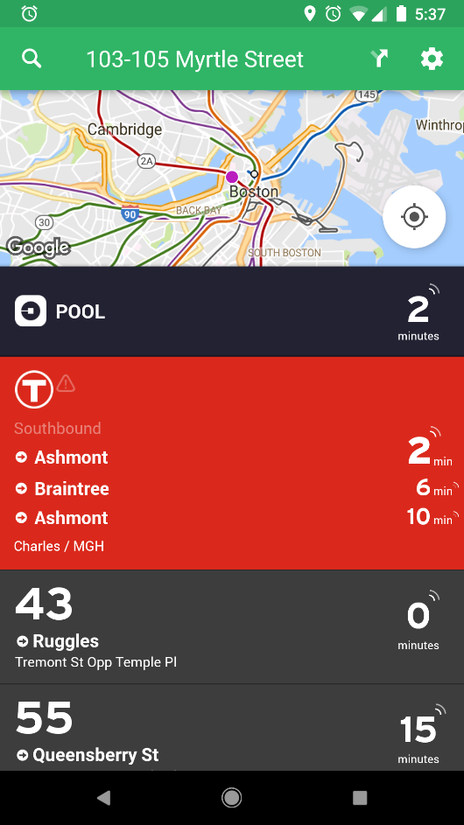
Improving Service Alerts
Increased integration into trip planning and smartphone apps (e.g., using geotargeting)
Transit
OneBusAway
Source: OneBusAway

Slide 30
Conclusions
With the opening of transit data, a plethora of applications have become available to riders.
Real-time information decreases (actual and perceived) wait times, increases satisfaction, and can increase ridership.
Service alerts allow agencies to communicate issues and delays to passengers.

Slide 31
References
The materials in this lecture were taken from:
Rojas, B.F.M., Weil, D., Graham, M., 2012. Transit Transparency: Effective Disclosure through Open Data. Cambridge, MA. <http://www.transparencypolicy.net/assets/FINAL_UTC_TransitTransparency_8%2028%202012.pdf> (retrieved 31.01.15).
Wong, James, et al. "Open Transit Data: State of the practice and experiences from participating agencies in the United States." Transportation Research Board 92nd Annual Meeting. No. 13-0186. 2013.
Watkins, K. E., Ferris, B., Borning, A., Rutherford, G. S., & Layton, D. (2011). Where Is My Bus? Impact of mobile real-time information on the perceived and actual wait time of transit riders. Transportation Research Part A: Policy and Practice, 45(8), 839–848.
Zhang, F., Shen, Q., & Clifton, K. J. (2008). Examination of Traveler Responses to Real-Time Information About Bus Arrivals Using Panel Data. Transportation Research Record: Journal of the Transportation Research Board, 2082, 107–115.
Tang, L., & Thakuriah, P. (Vonu). (2012). Ridership effects of real-time bus information system: A case study in the City of Chicago. Transportation Research Part C: Emerging Technologies, 22, 146–161.
Brakewood, Candace, Gregory Macfarlane, and Kari Watkins (2015). The Impact of Real-Time Information on Bus Ridership in New York City. Transportation Research Part C: Emerging Technologies, Volume 53, pp. 59-75

