Slide 1

Lecture #17: Ridership Forecasting
[Course Instructor]
[Course Semester]
[Course Number]
Materials developed by C. Brakewood, K. Watkins, and J. LaMondia.

Slide 2
Outline
Overview of transit demand
Methods to forecast ridership changes
Transit elasticity values
Travel demand models

Slide 3
Goal of Understanding Ridership
Tells us which changes are worth the time and monetary investments
Helps us anticipate how transit system operations will evolve
Improves our planning process for selecting the best alternative

Slide 4
Transit Travel Behavior
…is defined as: the direct and indirect ways in which patrons use the transit system, including:
  Number of trips
  Destinations
  Activities
  Trip patterns
  Timing
Notes:
The answer is looking at travel behavior! This is a large field within transportation, but not as much emphasis in transit area.
Explain that behavior includes all aspects of how we use a system. To best understand how to improve a system, we need to know how people use it.
Ask students to think about the last trip they took on transit – all those aspects of their trip are important to us.
Biggest one is whether or not even take transit!! … This idea leads into next slide

Slide 5
General Factors Affecting Travel Behavior
Transport System Context
Transit Service Characteristics
Transport Policies/ Perception
Region-level
Individual-level
Notes:
Three main groups of factors we will list out.
Emphasize that some are region level, others individual level. This means that some factors will influence regional groups of people, other factors will influence individual choices.
If we are planning and making decisions, need to be aware of which factors affect which decision-level.

Slide 6
1. Transport System Context
Population characteristics
Economic conditions
Cost & availability of alternative modes
Land use & development patterns
Travel conditions
Notes:
In these slides, talk about how some of these things will influence transit behavior.
Here are some examples:
Older populations more likely to use transit
Urban areas more likely to use transit
People with cars less likely to use transit
Poor traffic conditions lead to more transit use
NOTE: sometimes these are NOT generalizable!!

Slide 7
2. Transit Service Characteristics
Service adjustments/ improvements
Partnerships & coordination
Marketing, promotion and information initiatives
Fare collection & fare structure initiatives
Notes:
Examples:
How is service planned: when/where does it come?
Coordination with other regional transit service providers
Are there good maps/ apps available so people are well informed?
How does price affect ridership?

Slide 8
3. Transport Policies/ Perception
Price & availability of modes
Quality of service of modes
Characteristics of desired trips
Traveler motivation/ bias
Notes:
What is going to impact an individual in their decision to ride transit in a given way?

Slide 9
Relationships are not always clear
Confounding factors
  Additional factor that is the cause of behavior but is highly correlated with other factors
Lurking factors
  Additional factor that is the cause of behavior but is missed in analysis
Notes:
We need to evaluate cause-effect and that is hard, especially with these types of factors.

Slide 10
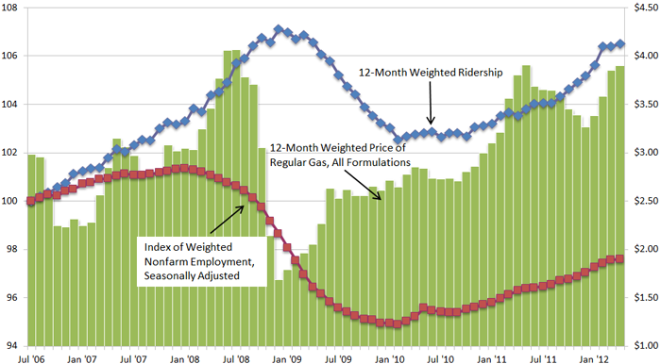
What is the Gas Price Tipping Point?
National Transit Database, U.S. Energy Information Administration's Gas Pump Data History, and Bureau of Labor Statistics' Employment Data.
Notes:
From National Transit Database (NTD): July 2006 – July 2012
Blue line: Transit ridership
Green bars: Gasoline prices
Red line: Employment levels
Complex relationship between transit ridership, gas prices, and employment.
High employment … high travel (both transit and individual vehicles)
Low gas prices … more individual vehicles trips and less transit

Slide 11
Future is Based on Behavioral Considerations
Estimation of future travel behavior is only as accurate as the estimates of future development.
Estimates are based on current conditions and behavior; assume people act the same in the future.
Estimates are determined by external factors as well as the type of system, so need to consider both.
Behavior is inherently individual, so should consider personal preferences/ biases.
Notes:
Considerations when we do any kind of behavior analysis

Slide 12
Behavior Review Process
Collect Information on Past Trends
Develop Relationship Trends
Estimate Future System Changes
Predict Future Travel Behavior
Notes:
Emphasize the order of the process. Collect info about today to predict the future.

Slide 13
Methods of Forecasting Ridership Changes
TCRP Synthesis 66, Chapters 3-4

Slide 14
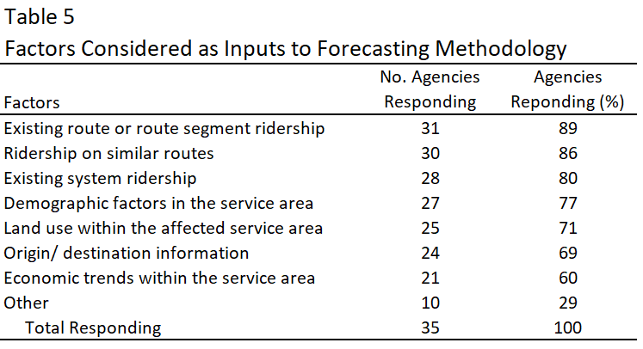
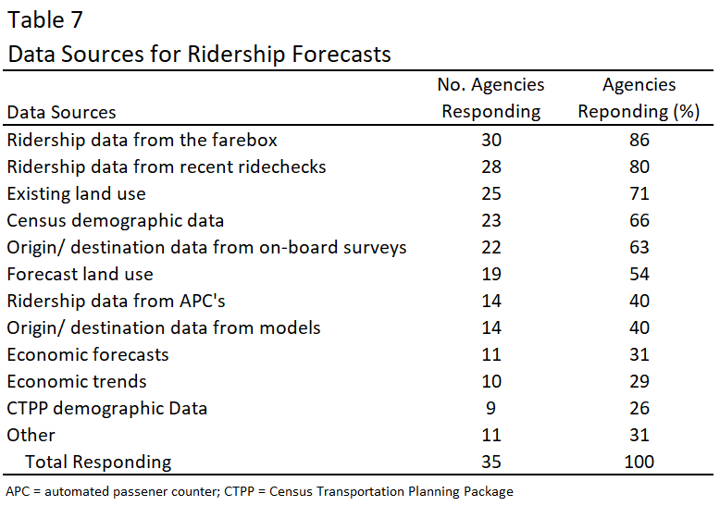
Data Sources & Inputs
Source: TCRP Synthesis 66, page 9
Notes:
Fixed-route transit ridership forecasting and service planning methods
Surveyed approximately 35 transit agencies: What data sources they were using and how they are forecasting.

Slide 15
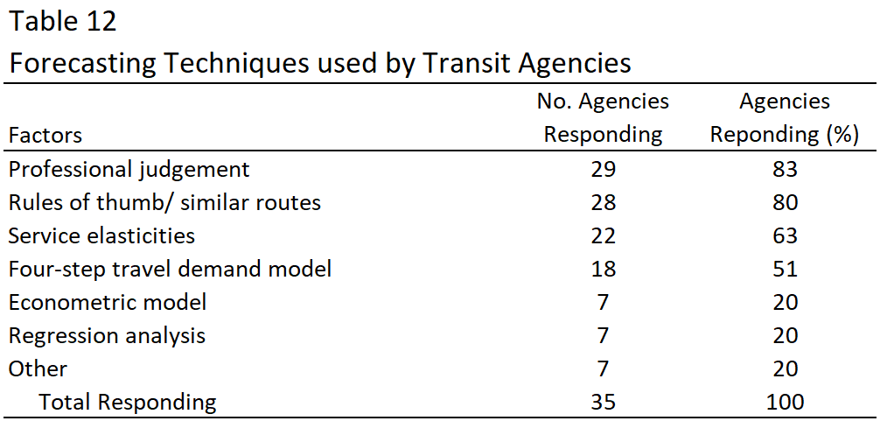
Forecasting Techniques
Source: TCRP Synthesis 66, pages 9-10
Notes:
We’ll go through service elasticities and the four-step travel demand model

Slide 16
Elasticity Calculations
Victoria Transport Policy Institute: Price Elasticities and Cross-Elasticities

Slide 17
Elasticities
Demand sensitivities are measured using elasticities
Demand elasticity is…
the percentage change in the number of riders as a result of a one-percent change in price
(or some other factor)
Example: Simpson-Curtin rule
  3% fare increase reduces ridership by 1%
Notes:
This rule comes from a number of sources, but it is to simplistic and out of date to be used in the real world. Every agency needs to come up with their own elasticities.

Slide 18
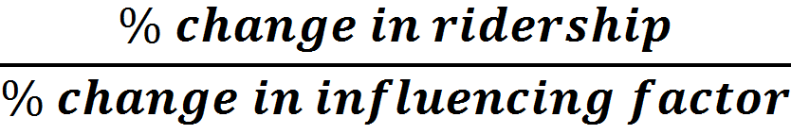
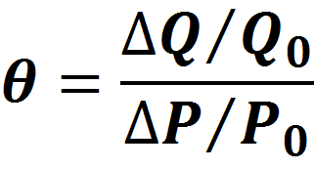
Elasticity Equation
Example:
Simpson-Curtin rule, 3% fare increase reduces ridership by 1%
Transit Price Elasticity = -0.33
Notes:
The base Q₀ and P₀ are the original values before changes

Slide 19
Elastic/ Inelastic Threshold
Range from -∞ to +∞
  + indicates an increase in ridership due to the 1% factor change
  indicates a reduction in ridership due to the 1% factor change
<|1| indicates inelasticity, with little impact
>|1| indicates elasticity, with high impact
Example:
Simpson-Curtin rule, Transit Price Elasticity = -0.33
Transit price elasticity is inelastic

Slide 20
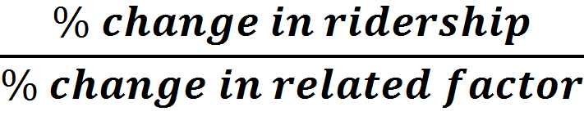
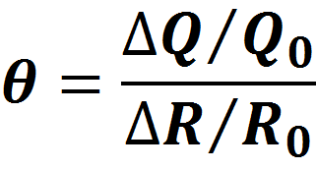
Cross-Elasticity
Notes:
Cross-elasticities refer to the percentage change in the consumption of a good resulting from a price change in another related good.
For example, automobile travel is complementary to vehicle parking and a substitute for transit travel, so an increase in the price of driving tends to reduce demand for parking and increase demand for transit.

Slide 21
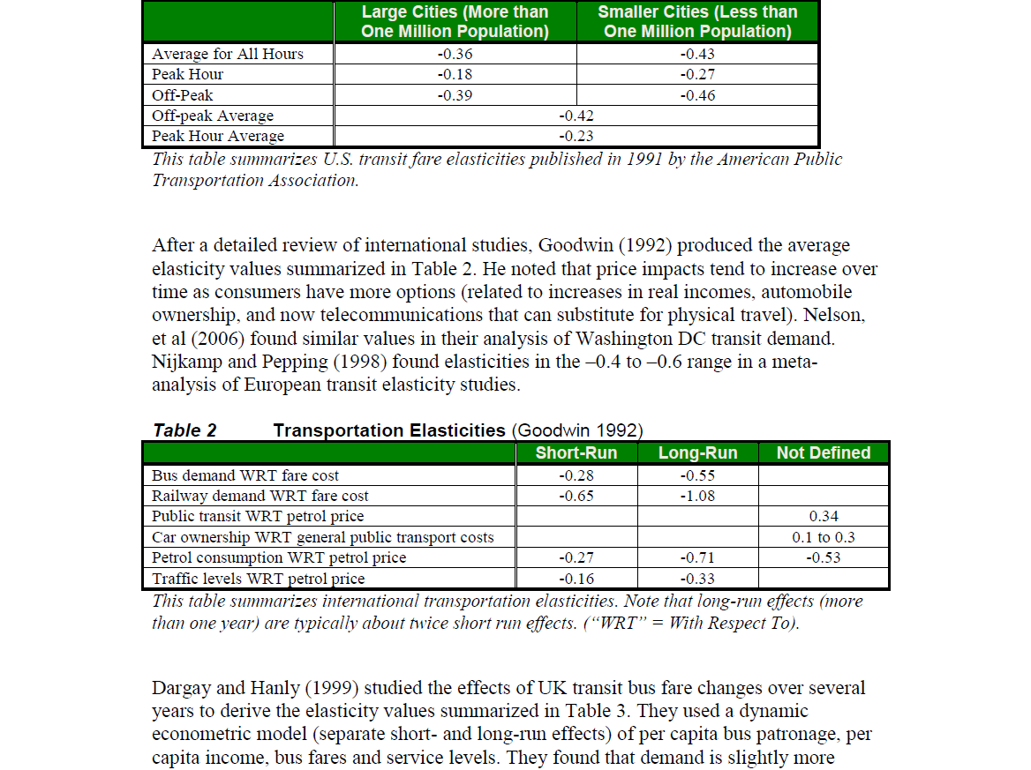
Examples of Elasticity Values
Litman, Page 7
Notes:
Average bus fare elasticity – about Simpson-Curtin rule
Peak hour – less sensitive to changes … people need to get to work (nondiscretionary trips)
Off-peak – more sensitive … more discretionary
Short run – less elastic
Long run – more elastic (you can buy a car)
Railway tends to have higher elasticity values (more sensitive to fare)
Cross-elasticities – petrol price – fairly low
Transit price elasticities are lower for transit dependent riders than for discretionary (“choice”) riders.
Elasticities are about twice as high for off-peak and leisure travel as for peak and commute travel.
Cross-elasticities between transit and automobile travel are relatively low in the short run (0.05) but increase over the long run (probably to 0.3 and perhaps as high as 0.4).

Slide 22
Participation Exercise
Calculating elasticity values

Slide 23
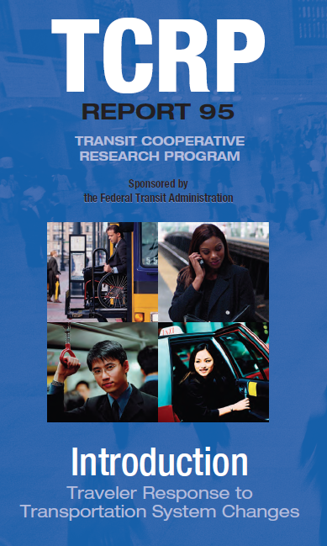
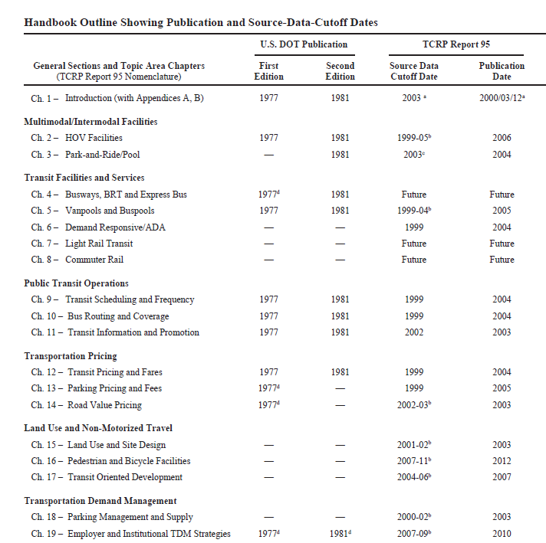
Additional Reference
http://onlinepubs.trb.org/onlinepubs/tcrp/tcrp_rpt_95c1.pdf
Notes:
Contains elasticity values for tons of things – modes, fares, frequencies, etc.

Slide 24
Travel Demand Models

Slide 25
Methods for Forecasting Demand
Collect Data Describing a Specific Area
Predict Total # Travelers
Predict % of Transit Riders
Predict # Transit Riders
Predict # Transit Riders
Determine the Total # of Transit Riders per Timeframe
Notes:
From data provided and predicted number of travelers, we are interested in the percent that will choose transit and that will give us the number of transit riders.

Slide 26
Methods for Forecasting Demand
Collect Data Describing a Specific Area
Predict Total # Travelers
Predict % of Transit Riders
Predict # Transit Riders
Predict # Transit Riders
Determine the Total # of Transit Riders per Timeframe
Notes:
Orange: elasticity
Blue: more common approach using travel demand model

Slide 27
General Demand Forecasting Process
Collect Current/ Past Behavior & Characteristic Data
Collect/Project Future Characteristic Data
Estimate Relationships Between Characteristics & Behavior
(DEMAND MODEL)
Apply Demand Model to Future Characteristic Data
Predict Future Behavior

Slide 28
Two Approaches
Route Level Demand Approach
System Demand Approach
Individual/ Aggregate
Large Spatial Scale
  Typically, a city or region
Policy/ Choice Analysis
  Mode choices
  Influence on congestion
Aggregate
Local Spatial Scale
  Typically, a route or stop
Volume Analysis
  Stop arrivals
  Rail system studies
  Ridership along route

Slide 29
Data Collection
Route Level Demand Approach
System Demand Approach
O-D Survey
Region level estimates and assumptions for the future growth
Route Opinion Survey
Route only estimates and assumptions for future growth

Slide 30
Mode Choice of the Decision Maker
n = Decision Maker
Choice between J alternatives (j = 1,.., J)
Utility n obtains for j is U_{nj}
Chooses alternative with MAX utility
Choose i if U_{ni} > U_{nj} for all j ≠ i
Notes:
The framework at the individual level: decision to take transit
Alternatives: auto bus carpool

Slide 31
Researcher
Researcher does NOT know utility
Observes attributes of alternatives (x_{nj})
Characteristics of decision maker (s_{n})
V_{nj} = V(x_{nj}, s_{n}) for all j
Notes:
V = representative utility
Attributes like travel time
Characteristics like annual household income level

Slide 32
Random Utility Models
U_{nj} = V_{nj} + ε_{nj}
U_{nj} = α_{j}X_{nj} + β_{j}Z_{nj} + … + ε_{nj}
U_{nj} is linear function to determine outcome j for observation n
α_{j} and β_{j} are parameters for outcome j
X_{nj} and Z_{nj} are observable characteristics
ε_{nj} is an error term

Slide 33
Types of Discrete Choice Models
Binary = 2 choices
Multinomial = 3 or more choices
Logit
GEV
Probit
Mixed Logit
ε_{nj}
Notes:
Change the assumption of the error term for other models
For logit, we assume that the error term has a logistic – or extreme value – distribution.
For probit, we assume that the error term takes a normal distribution.
GEV models are generalized extreme value distribution models – such as nested logit, cross nested logit, etc.
This class we will focus on the logit model, which is the most common

Slide 34
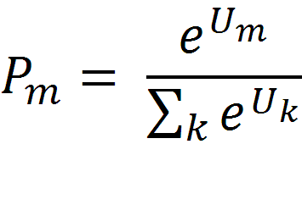
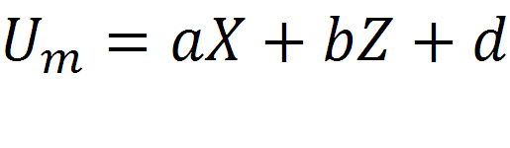
Logit Choice Model
Notes:
In mode choice, it’s not discrete, it’s probability
M = mode (auto bus carpool)
X= attributes of the alternatives
Z = characteristics of the decisions

Slide 35




Logit Choice Model
A
B
C
Notes:
A = auto
B = bus
C = carpool

Slide 36
Utility Equation
Characteristics of the Trip Maker
(income, gender, age, HH size, # cars)
Attributes of the Mode
(travel time & cost, others)
Notes:
Household (HH) size
Possible other things: Characteristics of the Trip (trip purpose, time of day)

Slide 37
Utility Variable Types
Generic variables
  multiple utility functions with same parameter
Alternative specific variable
  multiple utility functions with different parameters
Alternative specific constants
  constant for all alternatives but one
Socioeconomic variables
  alternative-specific
  combination with system variable

Slide 38
Estimation
Survey Data
  On-board transit surveys
  Revealed and stated preference surveys
Software
  Limdep – frequently used
  Biogeme – open-source freeware
Notes:
Limdep is an econometric and statistical software

Slide 39
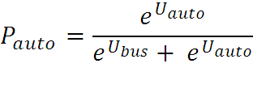
Mode Choice Example
Costs: Auto operating = $0.18 / mi
Parking = $10
Bus = $1.50
U_{auto} = -0.028 * time (in min) – 0.004 * cost (in cents)
U_{bus} = -0.028 * time (in min) – 0.004 * cost (in cents) – 4.52
Auto
8 miles
25 minutes
TAZ 1
TAZ 2
Bus
9 miles
45 minutes
Notes:
Why the -4.52? … the alternative specific constant
Notice: coefficient on travel time is negative and so is cost coefficient

Slide 40
Mode Choice Example
U_{auto} = -0.028*(25) – 0.004*[(18*8)+1000]
= -0.7 – 4.576 = -5.276
U_{bus} = -0.028*(45) – 0.004*(150) – 4.52
= -1.26 – 0.6 – 4.52 = -6.38
P_{auto} = e^{-5.276} P_{bus} = e^{-6.38}
e^{-5.276} + e^{-6.38} e^{-5.276} + e^{-6.38}
= 75% = 25%

Slide 41
Mode Choice Example
Costs : Auto operating = $0.18 / mi
Parking = FREE
Bus = $1.50
U_{auto} = -0.028 * time (in min) – 0.004 * cost (in cents)
U_{bus} = -0.028 * time (in min) – 0.004 * cost (in cents) – 4.52
Auto
8 miles
25 minutes
TAZ 1
TAZ 2
Bus
9 miles
45 minutes
Notes:
Change so that parking is free. This could be a policy we are considering.

Slide 42
Mode Choice Example
U_{auto} = -0.028*(25) – 0.004*(18*8)
= -0.7 – 0.576 = -1.276
U_{bus} = -0.028*(45) – 0.004*(150) – 4.52
= -1.26 – 0.6 – 4.52 = -6.38
P_{auto} = e^{-1.276} P_{bus} = e^{-6.38}
e^{-1.276} + e^{-6.38} e^{-1.276} + e^{-6.38}
= 99% = 1%

Slide 43

Independence of Irrelevant Alternatives (IIA)
Relative probability of choosing i over j depends only on i and j
Strengths
  Estimated from one choice set and predict from modified choice set
  No need to include all possible choices
Weakness
  Must be independent alternatives
Notes:
This is a mathematical shortcoming of the logit model. The denominator cancels out.

Slide 44

Red Bus, Blue Bus
Car
Bus
U_{car} = U_{bus} = 1

Slide 45
Red Bus, Blue Bus
Car
Bus
Car
Red Bus
Blue Bus
U_{car} = U_{bus} = 1

Slide 46
Red Bus, Blue Bus
Car
Bus
Car
Red Bus
Blue Bus
U_{car} = U_{bus} = 1
U_{car} = U_{red bus} = U_{blue bus} = 1

Slide 47
Puget Sound Regional Council (PSRC)
Mode Choice Model
SOV
Drive to Transit
Walk
HOV2
Bike
Walk to Transit
HOV3+
See: https://www.psrc.org/sites/default/files/2015psrc-modechoiceautomodels.pdf
Notes:
This is common in real-life. This is an example of the Puget Sound Regional Council’s mode choice model, which is from the Seattle area.
Look how similar the alternatives are. They are clearly correlated.
We can use a nested model to overcome this. Generalized extreme value models.

Slide 48
PSRC HBW
U_{SOV} = -0.0253*IVTT – 0.0038*Cost₁ – 0.0021Cost₂ – 0.0014Cost₃ – 0.0011*Cost₄ + MSP
U_{HOV2} = -0.0253*IVTT – 0.0038*Cost₁ – 0.0021Cost₂ – 0.0014Cost₃ – 0.0011*Cost₄ + 0.199*CBD – 2.355 + MSP
U_{HOV3+} = -0.0253*IVTT – 0.0038*Cost₁ – 0.0021Cost₂ – 0.0014Cost₃ – 0.0011*Cost₄ - 0.268*CBD – 3.968 + MSP
U_{TransitW} = -0.0253*IVTT – 0.0633*OVTT_{walk} – 0.0506*OVTT_{7min} – 0.0038*Cost₁ – 0.0021Cost₂ – 0.0014Cost₃ – 0.0011*Cost₄ +0.593*CBD + 0.351 + MSP
U_{Bike} = -0.1020*Time + 0.173*CBD – 1.151 + MSP
U_{Walk} = -0.0788*Time + 1.688*CBD + 0.491 + MSP
IVTT = in-vehicle travel time; OVTT = out-of-vehicle travel time
See ftp://ftp.ci.missoula.mt.us/DEV%20ftp%20files/Transportation/MPO/MODEL_ENHANCEMENT/RFP/Proposals/Cambridge_Systematics/Reference/PSRC.Model%20Doc(final).pdf
Notes:
Times include both IVTT (in vehicle travel time) & OVTT (out of vehicle travel time)
IVTT and OVTT = separate travel time
OVTT can be walk and car-to-transit (park and ride)
MSP = Market Segmentation Parameter - based on income & #vehicles vs. HH size
4 costs represent different HH income levels
Red: different household income levels = cost depends on household income
CBD represents land use (central business district). These are in the home-based work modes as additional bias constants.

Slide 49
Factors Affecting Demand
Service-related variables tend to overwhelm demographic and employment factors
  Fare costs
  Travel times
  Wait times
  Access/ egress distances

Slide 50
Which method for understanding ridership is best?
It all depends...
  How much information do you have?
  How accurate is your analysis?
  What is the scale of your analysis?
  How will it be used?

Slide 51
Conclusion
It is important to determine travel demand to plan for future service.
The elasticity of demand is the marginal change in ridership as a function of change in service quality or price.
Travel demand models are commonly used for long-term planning.

Slide 52
References
Materials in this lecture were taken from:
Vuchic (2007). Urban Transit. Chapter 10.
Litman. Victoria Transport Policy Institute: Price Elasticities and Cross-Elasticities.
TCRP Synthesis 66. Chapters 3-4.

